Slide 1

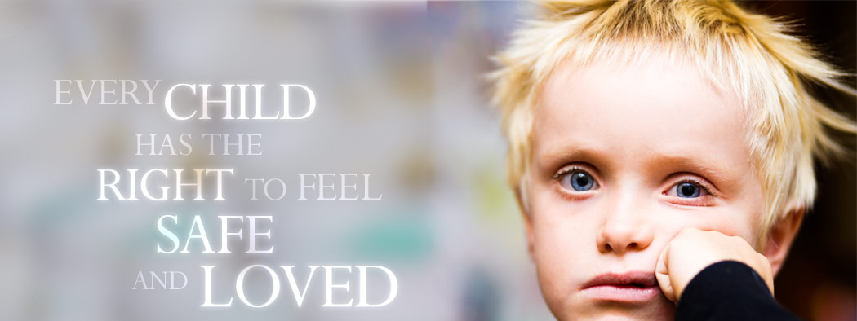
Victorian Child Safe Standards
Creating Child Safe Organisations and Environments –
City of Greater Geelong

Slide 2
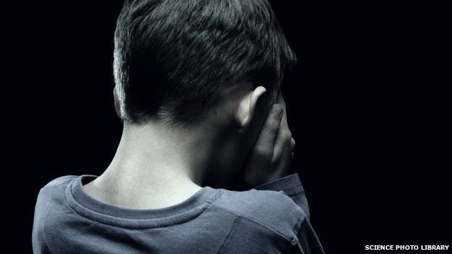
CHILDREN CANNOT STOP CHILD ABUSE.....
ONLY ADULTS CAN!

Slide 3
What Is Child Abuse?
Any child can be a victim of child abuse.
Child abuse can include physical abuse, sexual abuse, grooming, talking to a child in a sexually explicit way, or exposing them to pornographic material, emotional or physiological harm, neglect, exposure to family violence, etc.
The most recent national figures indicate that there are over 198,966 children in Australia annually suspected of being harmed or at risk of harm from abuse and/or neglect.
“On average, female victims were nine years old and male victims 10 years old when the abuse started. On average it took victims 22 years to disclose the abuse, men longer than women.” Royal Commission into Institutional Responses to Child Sexual Abuse

Slide 4
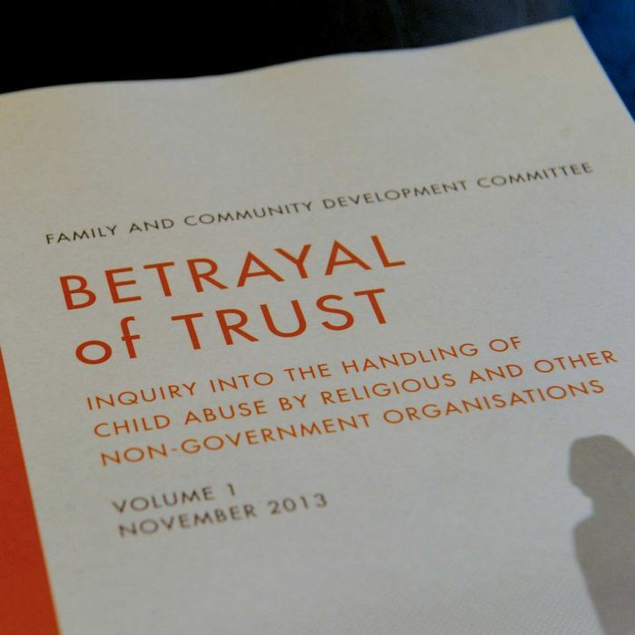
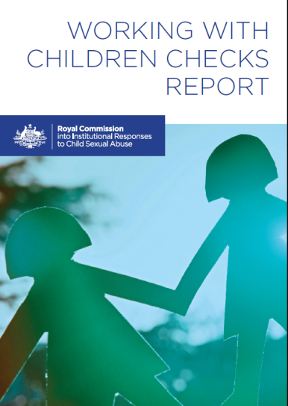

Background to the Standards
2012: Protecting Victoria’s Vulnerable Children Inquiry
2013: Commonwealth Royal Commission into Institutional Responses to Child Sexual Abuse
2014: Victorian Criminal Law Reforms introduced
2014: Victorian Government commits to implementing remaining Betrayal of Trust recommendations
2015: Legislation - Child Wellbeing and Safety Amendment (Child Safety Standards) Act 2015
2016: Phased commencement of the child safe standards for Category 1 organisations
2017: Commencement for second phase of the child safe standards for Category 2 organisations
Notes:
On 11 January 2013, the Prime Minister, announced the appointment of a six-member Royal Commission into Institutional Responses to Child Sexual Abuse and the release of the Terms of Reference that will guide the inquiry.
The Royal Commission is inquiring into how allegations and incidents of child sexual abuse and related matters that occurred in an institutional context have been managed and responded to. It will investigate how institutions and governments can better protect children, how they can achieve best practice in reporting and responding to incidents and how to address the impact of child sexual abuse.

Slide 5
Criminal Law Reforms
Three new criminal offences were introduced to improve responses within organisations and the community to child sexual abuse.
    Grooming offence targets communication, including online communication, with a child under the age of 16 or their parents with the intent of committing child sexual abuse.
Failure to disclose child sexual abuse offence that requires adults to report to police a reasonable belief that a sexual offence has been committed against a child (unless they have a reasonable excuse for not doing so). Maximum penalty is three years imprisonment
  It establishes that reporting child abuse is a community-wide responsibility.
Failure to protect a child from sexual abuse offence applies to people within organisations if:
    they hold a position of authority within a relevant organisation that works with children
    they know of a substantial risk another adult associated with the organisation may commit a sex offence against a child under 16 within the organisation’s care
    they have the power or responsibility to remove or reduce that risk
    but they negligently fail to do so.

Slide 6
What’s Meant by a Reasonable Belief?
Any adult who forms a reasonable belief that a sexual offence has been committed by an adult against a child under 16 has an obligation to report that information to police. Failure to disclose the information to police is a criminal offence.
A ‘reasonable belief’ is not the same as having proof. A ‘reasonable belief’ is formed if a reasonable person in the same position would have formed the belief on the same grounds.
For example, a ‘reasonable belief’ might be formed when:
a child states that they have been abused
a child states that they know someone who has been abused (sometimes the child may be talking about themselves)
someone who knows a child states that the child has been abused
professional observations of the child’s behaviour or development leads a professional to form a belief that the child has been abused
signs of abuse leads to a belief that the child has been abused

Slide 7
Child Safe Standards – Three Essential Principles
Designed to provide a framework to help organisations keep children safe from all forms of harm.
Are flexible and principle based to enable organisations to tailor their approach based on their type of organisation, level of responsibly for children and activities involving children.
In complying with the child safe standards an applicable entity or individual carrying on a business to which the standards apply must include the following principles as part of each standard:
    promoting the cultural safety of Aboriginal children
    promoting the cultural safety of children from culturally and/or linguistically diverse backgrounds
    promoting the safety of children with a disability.
    clear demonstration/evidence.

Slide 8
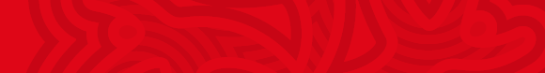
Standard 1:
Organisational culture and leadership
Leading from the top down and embedding a culture that makes child safety everyone's business.
This means:
protecting the interests of the child, not the organisation
making child safety a top priority in the organisation
taking a zero tolerance approach to child abuse, and to racial, religious or cultural discrimination
establishing clear values, behavioural expectations and recruitment practices that are consistent with a child centred, child safe culture
actively creating inclusive and cultural safe environments for Aboriginal and CALD children, and children with disabilities

Slide 9
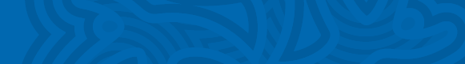
Standard 2:
Child safe policy or statement of commitment
Creating a foundation for a child safe environment
This means:
development of a whole of Council statement of commitment and/or child safety policy -
affirming a commitment to child safety and the best interests of children
making a commitment to child safety clear to people in the organisation, children and families and the community – promotion and education.
documenting how to meet duty of care and responsibilities to children
clear and consistent policies and procedures across the organisation.
including child safety statement of commitment in all relevant Council documents, publications, website, media release

Slide 10
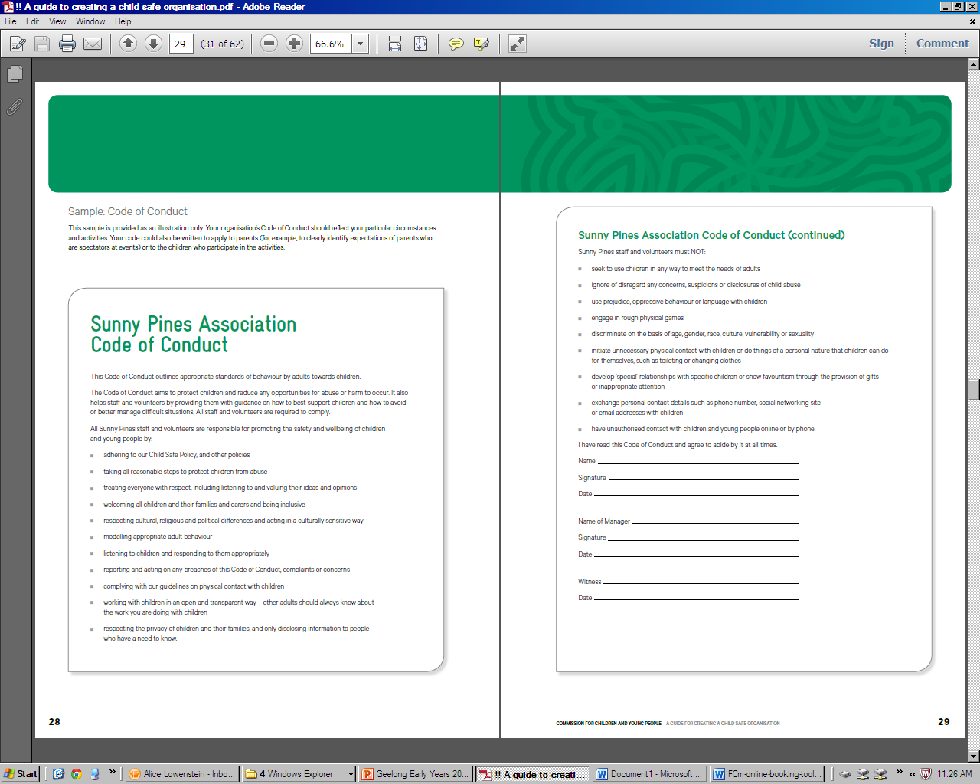
Standard 3:
Code of conduct
Setting clear expectations for appropriate behaviour with children
This means:
providing written guidance on appropriate conduct and behaviour towards and around children
  detailing acceptable and unacceptable behaviours in given situations, as it relates to the organisation’s context – for example physical contact, personal care, online communication, observation of behaviour, and staff supervision requirements and responsibilities.
educating staff, volunteers, contractors, parents and children about the expected standards of behaviour, supervision, and what will happen if a person does not comply with the necessary requirements.

Slide 11
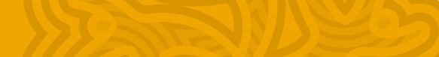
Standard 4:
Recruitment, induction, supervision and management
Effectively screening and training people in the organisation to reduce the risk of child abuse
This means:
having robust pre-employment screening and procurement processes that communicate a commitment to child safety
engaging only the most suitable people (whether paid, voluntary, or casual contractor) to work with children and/or around children and deterring unsuitable people from applying or being appointed
not seeing assessments and checks as a one-off activity – need for ongoing vigilance and continual supervision of staff, volunteers, contractors and children.
providing necessary induction, training and professional development for staff that specifically focuses on child safety.
Notes:
Communicate a strong message to staff, volunteers, contractors, and local community on Council’s child safety - child safety should be included in all position descriptions and documents relating to roles and responsibilities, and procurement requirements for external contractors.

Slide 12
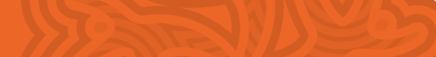
Standard 5:
Responding to and reporting abuse
Putting in place clear procedures for responding to and reporting child safety concerns or child abuse
This means:
children knowing who to talk to if they are worried, and are encouraged to report unsafe behaviours
people within the organisation are aware of their duty of care and legal responsibilities, and know what to do to respond appropriately and who to go to
concerns and complaints are acted upon appropriately, whether it is:
  about a staff member or volunteer, a contractor, another child, a child’s parent or carer or anyone else external to the organisation
  raised by a child, the child’s family, a staff member, volunteer or member of the public.

Slide 13
Standard 6:
Risk assessment and mitigation
Identifying potential for harm and proactively planning to prevent, reduce or remove the risk of child abuse
This means:
having a clear understanding of the vulnerabilities of the organisation (and the specific services, programs and/or activities provided) and the potential risks this may pose to children
being proactive to reduce the likelihood of risks emerging or escalating
adopting a risk management approach and developing a risk management plan with appropriate control measures.
audit and assess current policies, practices, and systems to identify what is already in place, where there gaps or areas for improvement
  implement clear and consistent corporate protocols to detect, address, and respond to allegations and substantiated cases of child abuse.

Slide 14
Standard 7:
Empowerment and participation
Supporting children and young people to understand their rights, contribute to child safety planning and to raise concerns
This means:
valuing and respecting children’s opinions
encouraging children’s participation in decision making
establishing an environment of trust and inclusion that enables children to ask questions and speak up if they are worried or feeling unsafe.
observation of children’s behaviour
active promotion of children’s safety
Notes:
Almost all children and young people spoke about strategies they felt were helpful in keeping themselves safe. Three kinds of strategies were discussed – managing feelings, ensuring physical safety and seeking help.

Slide 15
Still to be done………………………
Training: rolled out July onwards – on-line & face- to-face
Review of PDs & Recruitment Process: Commenced & ongoing
Department/Unit Risk Assessments: commenced & ongoing
Reporting & Responding Process: ongoing review
Contractors, Tenants etc.: to commence including discussions etc

Slide 16
Our expectations…………………………
We are not the “police” … each tenant, contractor etc. is responsible to be complainant with CCS
We will be asking for evidence….To Be Determined
Things like: copy of CSS Policy
Code of Conduct
Reporting Process
Training Tools

Slide 17
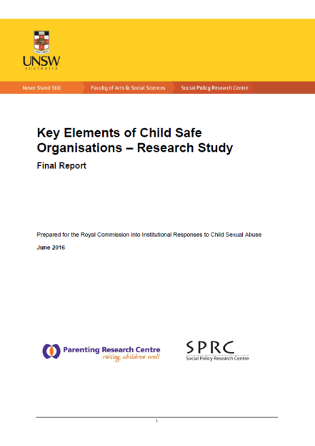
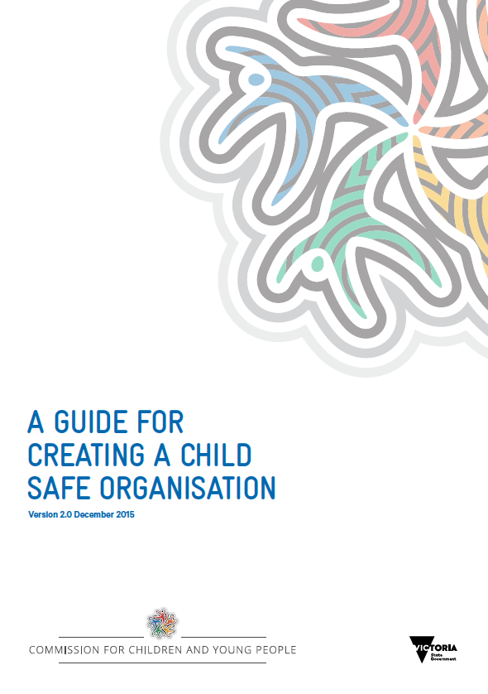
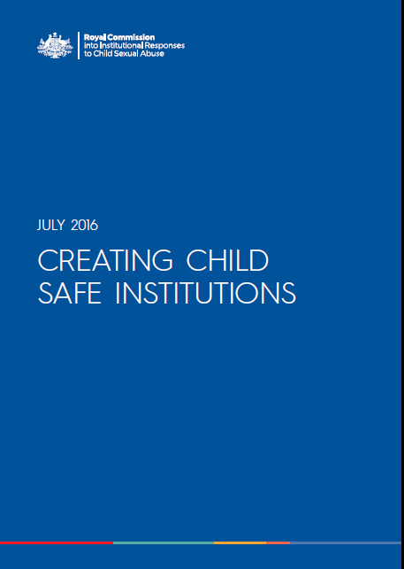
Further Information and Resources
Email childsafestandards@dhs.vic.gov.au
http://www.dhs.vic.gov.au/about-the-department/documents-and-resources/policies,-guidelines-and-legislation/child-safe-standards
http://www.dhs.vic.gov.au/about-the-department/documents-and-resources/policies,-guidelines-and-legislation/child-safe-standards-resources
Victorian Commission for Children and Young People http://www.ccyp.vic.gov.au/child-safe-standards.htm
The Australian Council for Children and Youth Organisation’s Safeguarding Children is an accreditation program run by the Australian Childhood Foundation www.safeguardingchildren.com.au
Life Without Barriers –We Put Children First www.lwb.org.au/childrenfirst
Childwise has published 12 Steps to Building Child Safe Organisations and conducts regular training, such as Choose with Care and cyber safety programs www.childwise.net
https://aifs.gov.au/cfca/topics/child-safe-organisations

