Slide 1
The Gordon Skills and Jobs Centre

Slide 2
A little bit about us
Workforce Development Centre opened in 2014 as a temporary Skilling the Bay project with a focus on providing career assistance to retrenched workers and their families;
Due to demand in Geelong our services expanded to provide assistance to various local job seekers.
A new State Government provided further funding and the opportunity to rebrand. So we became the Skills and Jobs Centre where we act as a point-of-call for members of the community and students seeking in the Geelong and Wyndham regions :
Career & employment coaching and advice
Training, retraining and industry skills guidance
Workshops and career transition programs
Job market and job opportunity information

Slide 3
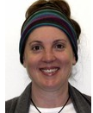
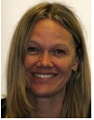
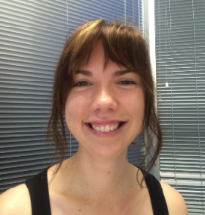
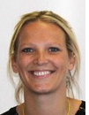
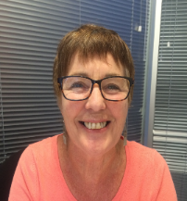
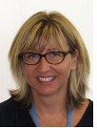
The Team
Erika
Advisor and
extra-ordinary
program and
workshop
Facilitator.
Erika is driven by
empowering and advocating vulnerable people and has run
several successful
programs in this
space.
Christina
Career Counsellor
and administrative
genius. Christina has
previously worked as
a Course Advice Specialist
at Swinburne University
and has a keen interest in helping people find
the right educational
pathway to attain their
career goals.
Tracey
Career
Counsellor &
#inhouseblogger.
Tracey comes from a previous role in careers counselling in a secondary school environment. She is our advocate for youth career development and assisting all members of the community.
Robyn
Career
Counsellor & \ expert
Industry relationship builder who in in the past worked as a lawyer, an woodwork and art teacher
with previous tertiary institutions.
She is focussed on individuals and empowering
individuals to make informed
career choices.
Jodie
Advisor,
Gordon expert
and &
Community
Service Liaison. Jodie is a font of all knowledge in terms of the Geelong labour market and industry requirements. And she can sing!
Tanya
Co-ordinator & Career Consultant
Previously worked
in Higher Ed as a Career and Employment Team Leader and with
“at risk youth” as a training facilitator

Slide 4
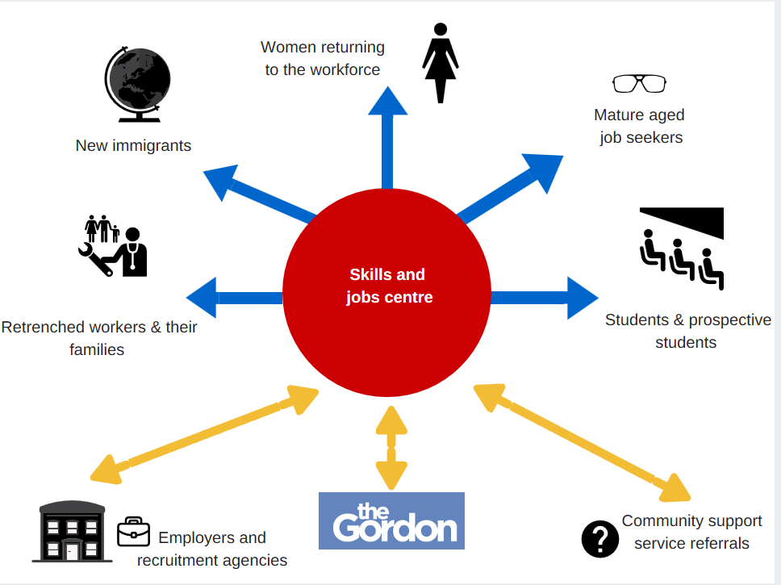
Skills and attributes sought by employers -
1.
Interpersonal and communication skills (written and oral)
2.
Drive and commitment/industry knowledge
3.
Critical reasoning and analytical skills/technical skills
4.
Cultural alignment/values fit
5.
Work & life experience, the ability to work in a team
Emotional intelligence (self-awareness, confidence, motivation)
7.
Leadership skill
8.
Activities (including intra and extracurricular)
6

Slide 5
? ? ? ?
Quiz
&
Stories

Slide 6
What’s on & get in touch
Next employment transition workshop series
Become a standout applicant (Personal brand) , Crafting an effective resume , The Hidden Job Market, interviews, and starting soon workplace jargon buster - Mondays & Thursday 10am -12pm
The Work Wise Women Program; Aims to inspire women to make sustainable careers decisions. The program is open to all women, but is particularly relevant for those who have faced barriers to career transition, have been, or are partners of retrenched workers, returning to work, or other women who maybe experiencing stress or anxiety around work transitional process.
Focuses on identifying skills, strengths and establishing work goals in a safe and supportive environment.
Connect or contact us
Ph. 03 5225 0700
Email. skillscentre@gordontafe.edu.au
skillscentregeelong.org.au

