Slide 1
Learning for life?
The role of neighbourhood houses for second chance learners
Dr. Tracey Ollis,
Dr. Jennifer Angwin,
Cheryl Ryan,
Ursula Harrison
School of Education
Deakin University
Thanks to Christine Brooks and the houses in the Barwon Network of Neighbourhood Centres.

Slide 2
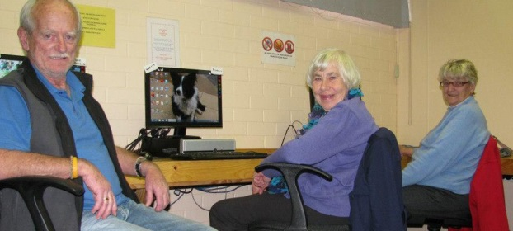
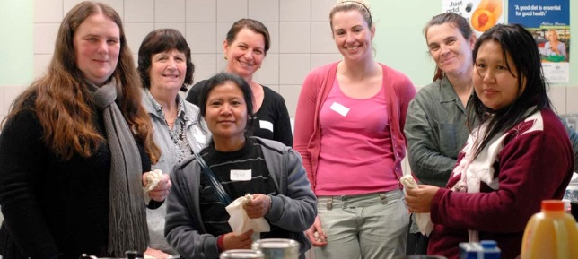
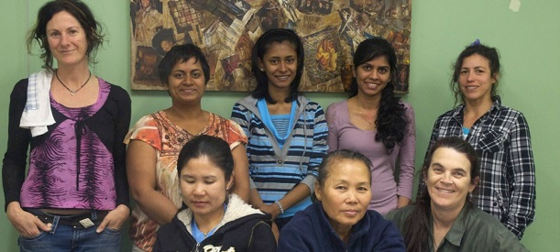
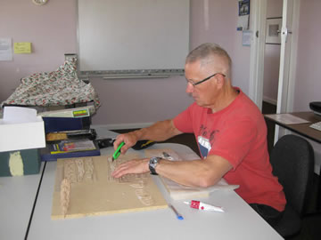

Slide 3
Geelong and surrounds
Geelong area has been affected by changes to traditional industries and employment opportunities
Declining manufacturing industries, Ford, Alcoa
Skilling the Bay initiative addresses the changing employment and industry landscape through “the development and implementation of an education and training led model of business growth and job creation” (STB 2013)
Neighbourhood houses in the Barwon Network are engaged with and responding to these initiatives

Slide 4
Methodology
Qualitative research
Critical pedagogical lens applied to the analysis of multiple case studies
Exploring the practices, habits and dispositions of participants in NH programs (Bourdieu, 1991).
Multiple case study research
Partnership with Barwon Network – 11 houses
Association with South West NH network (extended research project)
50 semi-structured interviews with NH learners
Profile of participants: 24 interviews completed (BNNC)
19 women, 5 men
Ages range from 22 – 66
Single mothers, retrenched workers, disability, CALD, long term unemployed, young adults
4 completed all years of secondary schooling

Slide 5
Second chance learning
Neighbourhood houses can be viewed as sites of ‘second chance education’ and learning (Robertson, Hoare & Harwood 2011)
Learners who are re-engaging with education and learning following disengagement from traditional sites of education such as schools, TAFES and universities.
Second chance learners can also be understood as those returning to study in order to up-grade their qualifications (Hoare)

Slide 6
Public pedagogy and Neighbourhood Houses
‘We are constantly being taught, constantly learn and constantly unlearn. Education is an enveloping concept, a dimension of culture that maintains dominant practices while also offering spaces for their critique and reimagining’… ‘they deal with bigger more pressing issues of cultivating a pedagogy of humanity, which ultimately has implications for schooling and non-schools settings. These are public pedagogies – spaces sites and languages of education and learning that sit outside the walls of the institutions of schools
(Sandlin, Schultz, & Burdick, 2010, p. 1).

Slide 7
Neighbourhood houses and learning
Education is an important aspect of the Community Development work of Neighbourhood houses (Rooney 2011)
Learning in NHs is not confined to instrumental knowledge, also transformative (Kimberley 1998, Foley 1993, 2001)
Range of programs: vocational, general adult education, social support, health and wellbeing
Targetted programs – unemployment, youth issues, domestic violence, parenting, disability.
47% of houses statewide offer accredited training (ANHLC 2014)
64% of houses statewide offer pre-accredited and preparatory education programs (ANHLC 2014)

Slide 8
Second chance learning
Second chance learners often have a negative self-perception based on lack of achievement of educational milestones
‘I guess I thought that in a way being thirty-seven I couldn’t learn anymore’ (Marta)
‘So just learning was a big thing and retaining information that was one of the biggest things’ (Kate)
Many have poor literacy and numeracy skills due to non-completion of secondary education (Robertson et al 2011)
‘There was a Course you could do, a Lab Technician Course but at the time Maths and Chemistry wasn’t my strongest, I found it a little bit too hard…back then it was a bit confusing’ (Bob)
A strong motivation to learn because they wish to enter or re-enter the workforce, improve their workplace status, or for personal interest.
‘So I’m really looking forward to what I’m going to learn in the future, and whether I’m going to learn anymore’ (Marta)

Slide 9
Emerging Themes
Significant numbers of early school leavers and mature aged unemployed
Issues of equity and access to skill development, courses and learning
Enhanced social and interpersonal skills through course participation, volunteering and building of social networks and friendships
Learner agency - realising the potential for future learning
Transitions from NH education programs to work, volunteering and further education

Slide 10
Emerging Themes – education and employment outcomes
‘I’ve learnt how to put a computer together because I got a computer…and I didn’t know how to do it properly and I thought my mouse was broken and the keyboard was broken but it wasn’t it was just that I didn’t put it in the right way. I found out that if I didn’t work that out it would have cost me about ninety dollars for a person to come in and put it into where it was meant to be’ (Curly)
‘So if the question is ‘did it help you get employment,’ well ‘yes’ (Allan)
‘I find it has helped me to refine my search skills and I believe I am pretty good with, even though my children could probably tell you different, I believe I’m pretty good with the computer’ (Kupi)

Slide 11
Emerging Themes – personal and social
‘It’s impacted greatly I know that, I’m definitely more compassionate as well, I’ve always been a compassionate person but not to the level that I am now. I see things from not just my perspective but now I put myself in other people’s shoes’ (Bianca) – change in self
‘I suppose there’s been a hard side of it trying to fit everything in, working and studying and being a mum so there’s a juggle there’ (Bird) – juggling competing interests
‘So coming here it was like ‘wow I’m not silly’, just coming here and seeing things from a different way it was like ‘I’ll be able to do this by myself’(Kate) – reconstructing learner identity
‘Also there’s one more thing, the welcoming feeling that you get when you walk in you think, “okay I belong somewhere I’m not home alone” ’ (Sophia) – being connected to others

Slide 12
Joy - Learning as text and poetry
I’ve always had big dreams.
Always wanted to try and achieve them.
Always had a dream of opening up an animal shelter.
Yeh, I’ve always had big dreams.
My mother passed away
at thirteen, I moved out of home lived on my own
at sixteen in foster care
Dropped out of school in year 10,
Moved around, no stable home, nowhere to go.
At nineteen, had my first child
At twenty two my 2nd daughter was born.
I found the neighbourhood house
Enrolled in a course,
Computers for my homework,
Help out my classmates
I’m learning
About the business
Got a website
Really proud of that
I have the passion, I really want to do it,
Ask anyone in class, they’ll say I’m a nerd
Eager to learn
I’m 24 now, and I’m learning about MY business.

Slide 13
Habitus and field– Neighbourhood Houses social space
‘This makes you feel like everybody is welcome and everybody is just as important as the next person, yeah you’re just so welcome and they’ll do anything they can to try and help you. We got lunch served here and it was just amazing, just this environment, everyone here is lovely and everyone here knows your name’ (Bianca)
‘I really loved the way the course was provided, loved the setting, small group, adult environment, it really suited me’ (Sarah)
‘But without a facility like this I’d be lost, I don’t have Internet at home unless it’s on my phone so to be able to come here even on days I don’t have school and do it, it makes it a hundred times better than any general schooling’ (Joy)

Slide 14
Habitus and field– Neighbourhood Houses social space
‘So the people in the class have been a great support and I think that makes the overall course a fantastic thing’.
‘It’s not like a school setting, this place doesn’t remind me of school it’s a gathering of people who want to learn in a friendly environment. I enjoy working in something like this than a TAFE or at a school, somewhere where it doesn’t feel like a school but we’re still learning we’re still getting an education.’

Slide 15
Identity change – learning to ‘become’ a student, learner, worker
Transformative and emancipatory – “process of conscientization is defined as the process by which students, as empowerment subjects, achieve a deepening awareness of the social realities which shape their lives and discover their own capacity to recreate them (Darder, 2003,p.4)

Slide 16
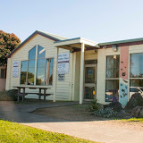
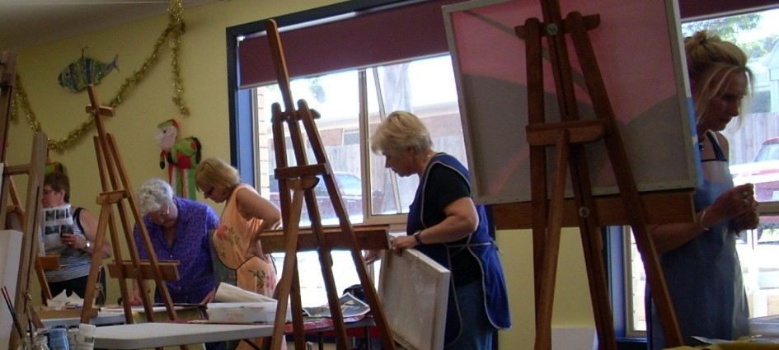
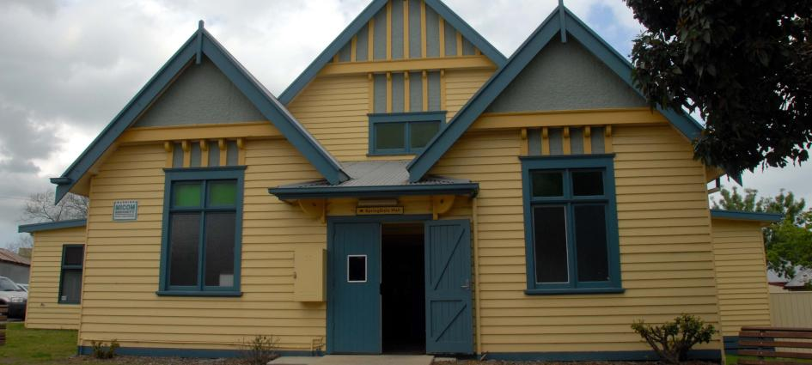
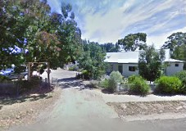

Slide 17
References
Association of Neighbourhood Houses and Learning Centres (2015). Neighbourhood Houses Survey 2014, ANHLC: Melbourne.
Bourdieu, P. (1977). Outline of a theory of practice. Cambridge: New York, Cambridge University Press.
Darder, A., et al.(Eds). (2003). The Critical Pedagogy Reader. Routledge, Falmer: London.
Humpage, L. (2005) Building Victorian Communities: Outcomes of the Neighbourhood House and Learning Centre Sector, Centre for Applied Social Research, RMIT: Melbourne.
Robertson, S., Hoare, L., Harwood, A., (2011). Returnees, student-migrants and second chance learners: case studies of positional and transformative outcomes of Australian international education. Compare – a Journal of Comparative and International Education, Vol 41(5), 685 – 698.
Rooney, D., (2011) Centres “down under”: Mapping Australia’s neighbourhood centres and learning. Australian Journal of Adult Learning, Vol 51(2), 203-225.

