Slide 1
The future of work
Dr. Jude Walker

Slide 2
The global picture

Slide 3
What’s happening in the world of work?
Current shortfall of 1.8 billion jobs
Trapp, 2012
2 billion jobs to disappear by 2030
US futurist Thomas Frey, 2012
http://www.futuristspeaker.com/2012/02/2-billion-jobs-to-disappear-by-2030/

Slide 4
Global growth industries
Green and sustainable energy (projected growth of 20%)
Personal care – strategies to address health problems (projected growth of 15%)
On-line and for-profit education services (projected growth of 10.7%)
Social network games (projected growth of 2.2%)
Mobile app’s (projected annual growth of 128%)
3D printing (projected growth of 14%)
http://venturebeat.com/2013/07/27/the-7-fastest-growing-industries-of-2013-infographic/

Slide 5
The national picture

Slide 6
National growth industries
Gas: off-shore oil and gas development. In addition, coal seam and shale gas industries are just starting in Australia.
Tourism
Agribusiness
Health: including biopharmaceutical research and biotechnology. The biotechnology industry includes national revenue of $6B, annual growth of 1.7% and employs 17, 519 people.
International education
Wealth management
http://www.ibisworld.com.au/industry/default.aspx?indid=1901

Slide 7
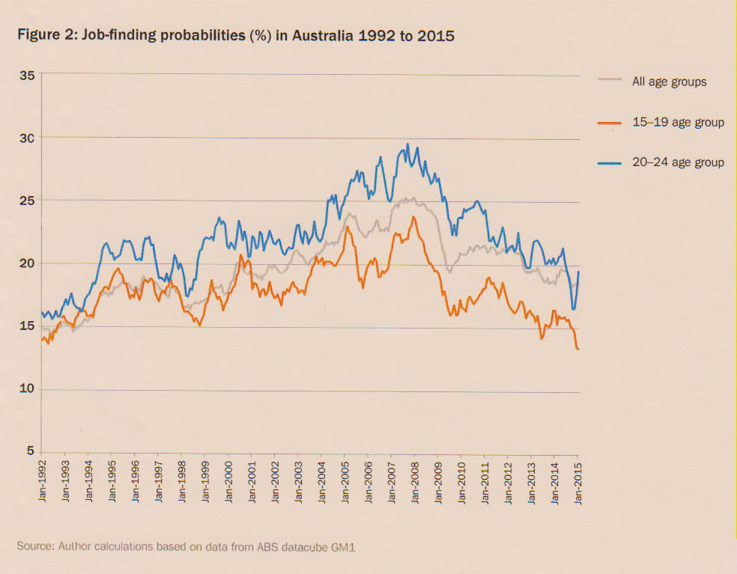
What’s happening with youth?
Brotherhood of St. Laurence, The Teenage Dream Unravels: Trends in Youth Unemployment, March 2015

Slide 8
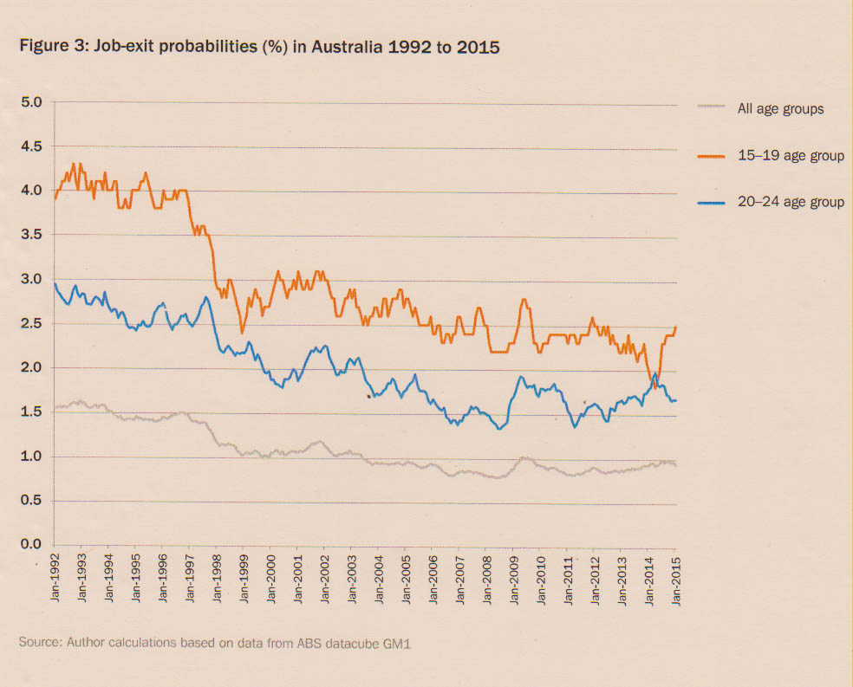
What’s happening with youth?
Brotherhood of St. Laurence, The Teenage Dream Unravels: Trends in Youth Unemployment, March 2015

Slide 9
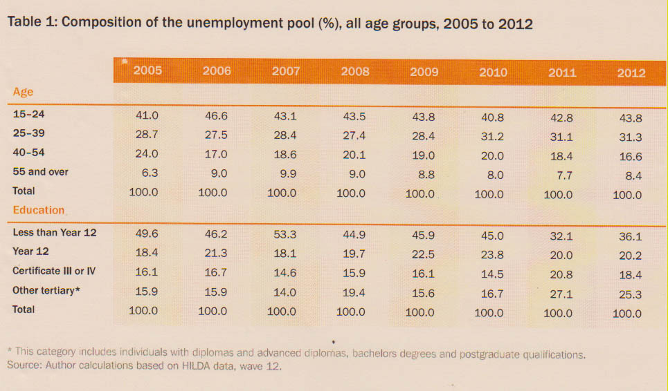
What’s happening with youth?
Brotherhood of St. Laurence, The Teenage Dream Unravels: Trends in Youth Unemployment, March 2015

Slide 10
The regional picture

Slide 11
Regional growth industries
Construction
Education and training
Property and business services
Health and community services
Transport, warehousing and logistics
Tourism
Agriculture and related industries, including agri-business, agri-science, agri-tourism and agri-food
Advanced manufacturing
ICT (enabling industry)

Slide 12
What might the future hold?

Slide 13
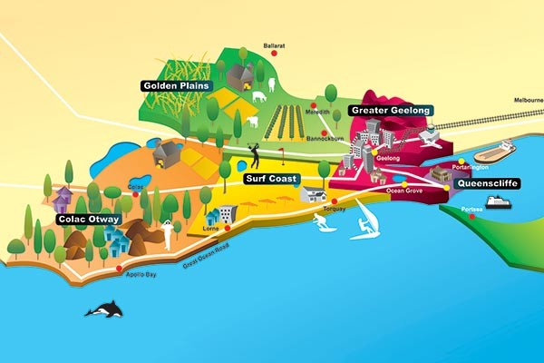
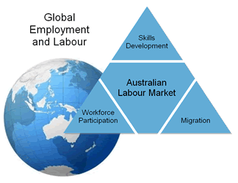
Stable environment
Stable labour market

Slide 14
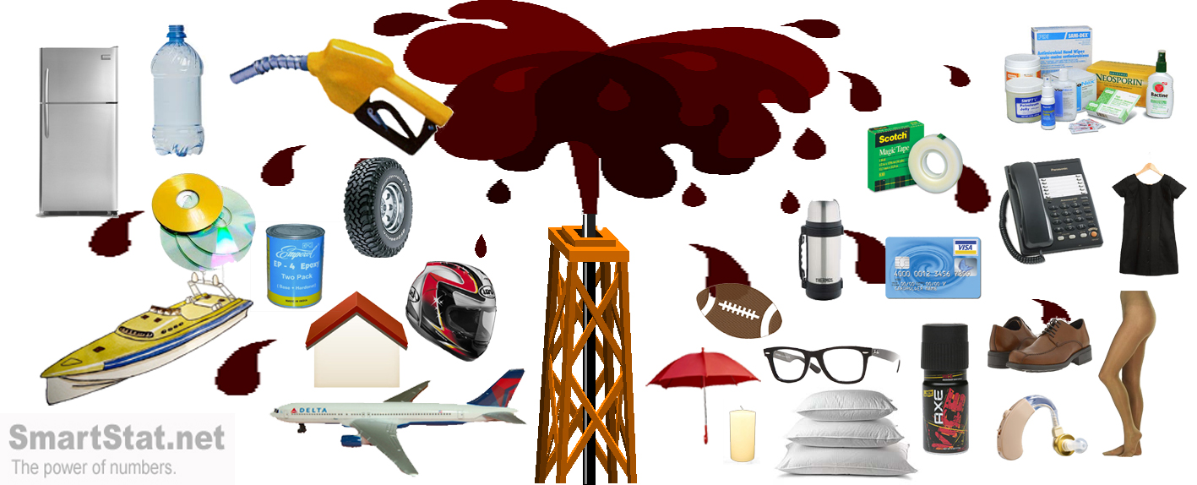
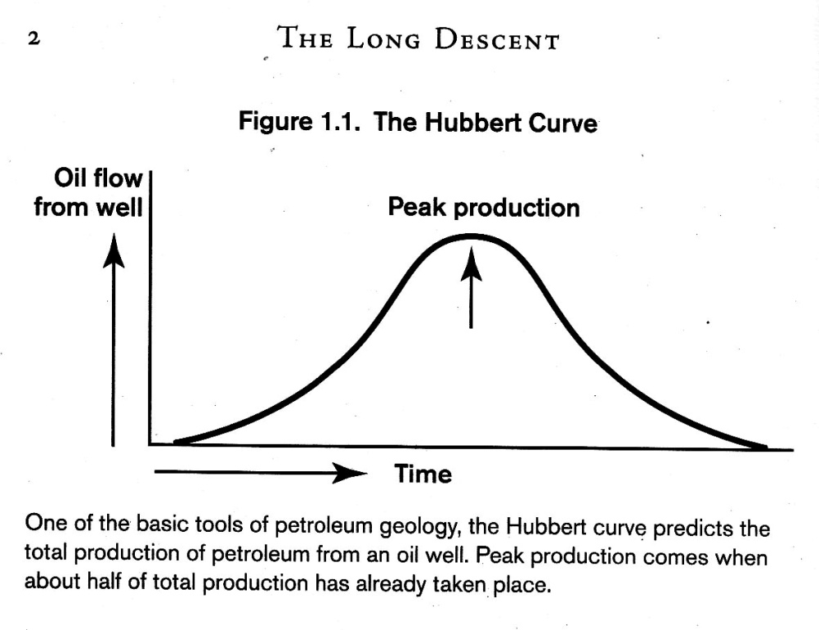
--> 2 possible futures

Slide 15
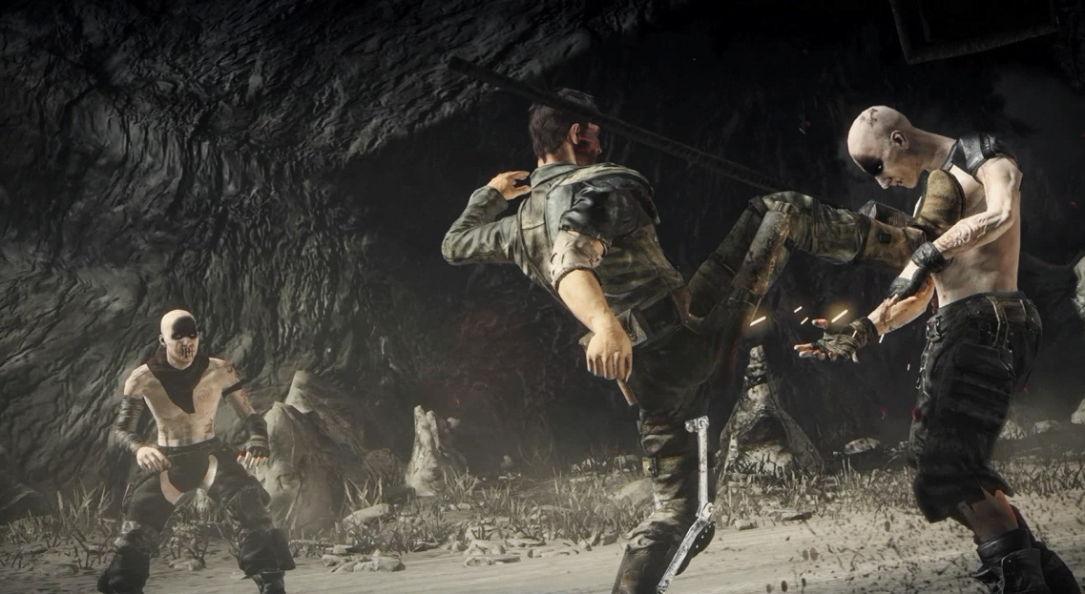
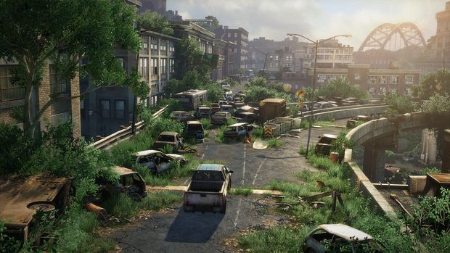
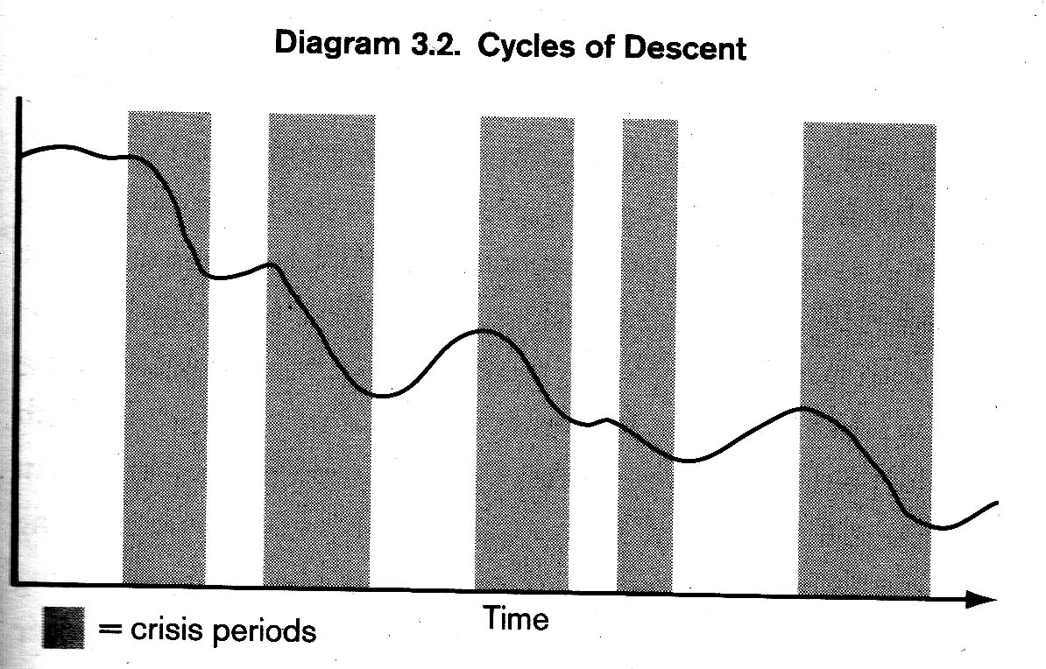
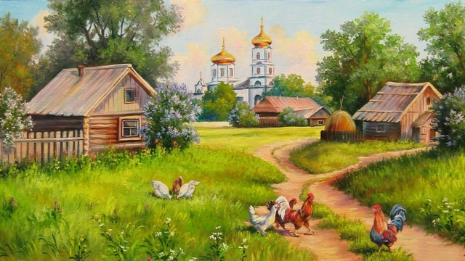
Greer, John Michael
The Long Descent

Slide 16
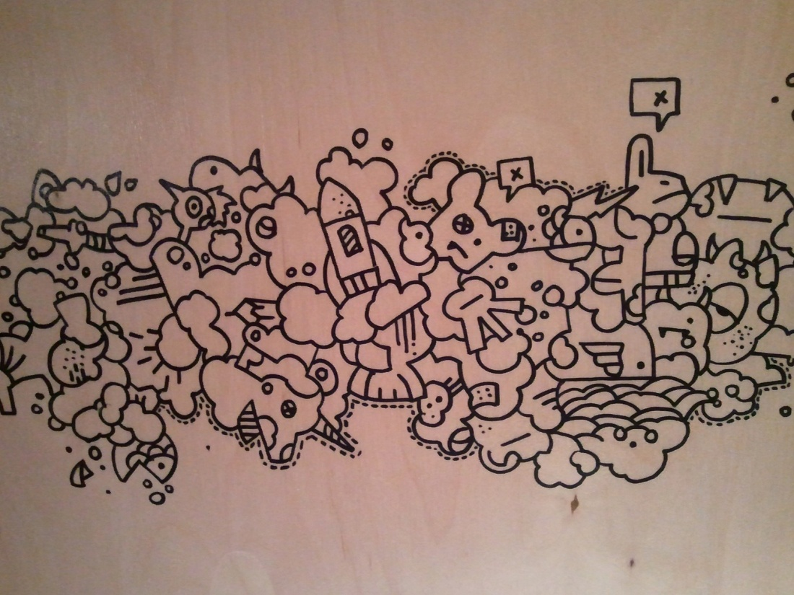
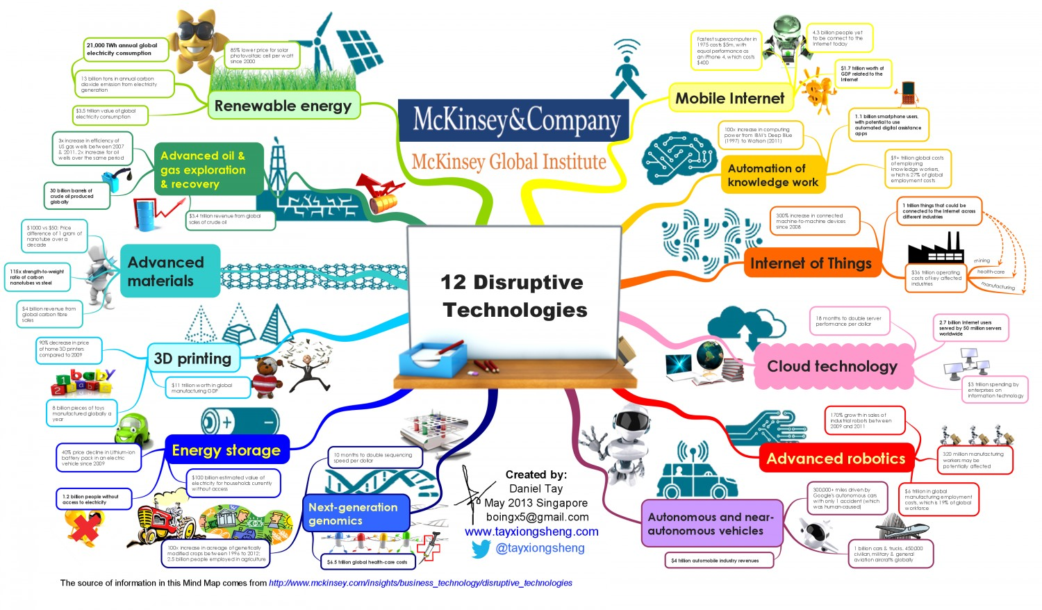
Chaotic environments
Disruptive technologies

Slide 17
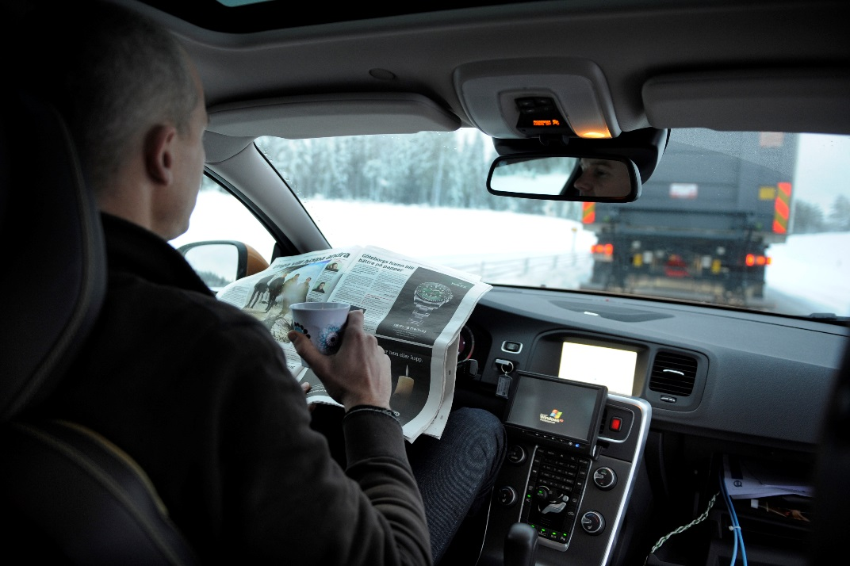
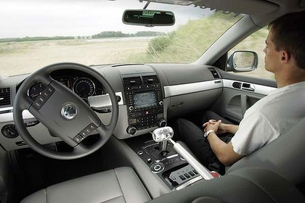
Transport

Slide 18
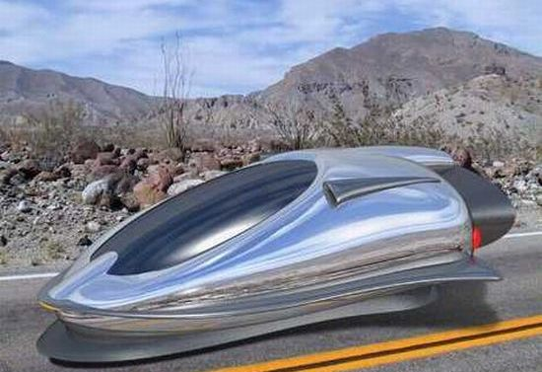
What’s happening in the world of work?
Automobile Transportation – Going Driverless
Jobs Going Away
Taxi and limo drivers, gone.
Bus drivers, gone.
Truck drivers, gone.
Gas stations, parking lots, traffic cops, traffic courts, gone.
Fewer doctors and nurses will be needed to treat injuries.
Pizza (and other food) delivery drivers, gone.
Mail delivery drivers, gone.
FedEx and UPS delivery jobs, gone.
As people shift from owning their own vehicles to a transportation-on-demand system, the total number of vehicles manufactured will also begin to decline.

Slide 19
What’s happening in the world of work?
Automobile Transportation – Going Driverless
New Jobs Created
Delivery dispatchers
Traffic monitoring systems, although automated, will require a management team.
Automated traffic designers, architects, and engineers
Driverless “ride experience” people.
Driverless operating system engineers.
Emergency crews for when things go wrong.

Slide 20
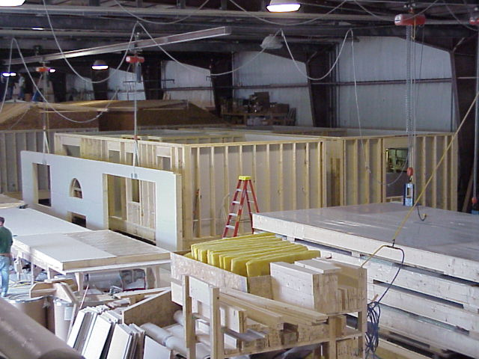
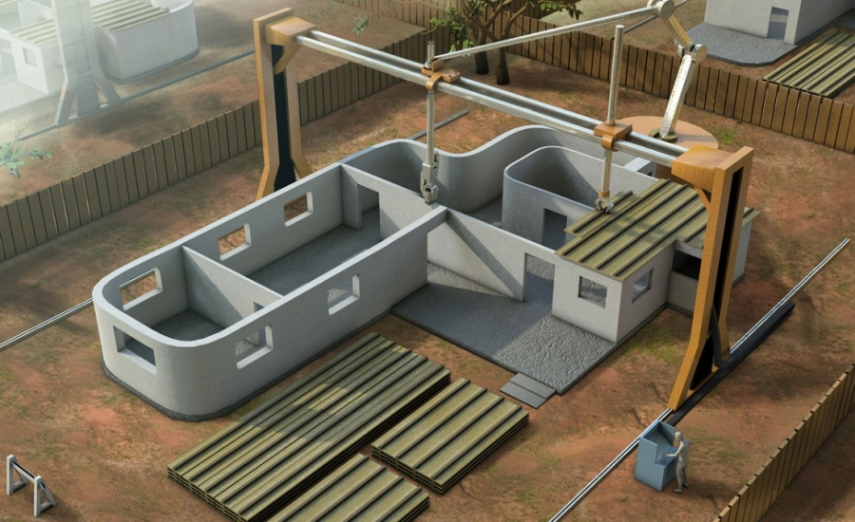
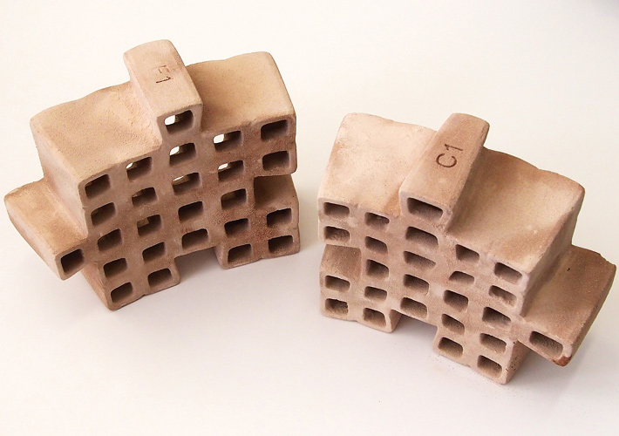
Construction

Slide 21
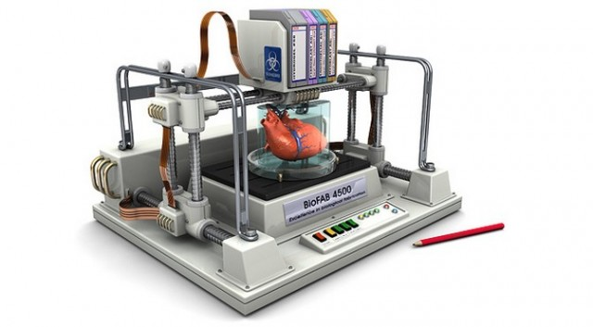
Health

Slide 22
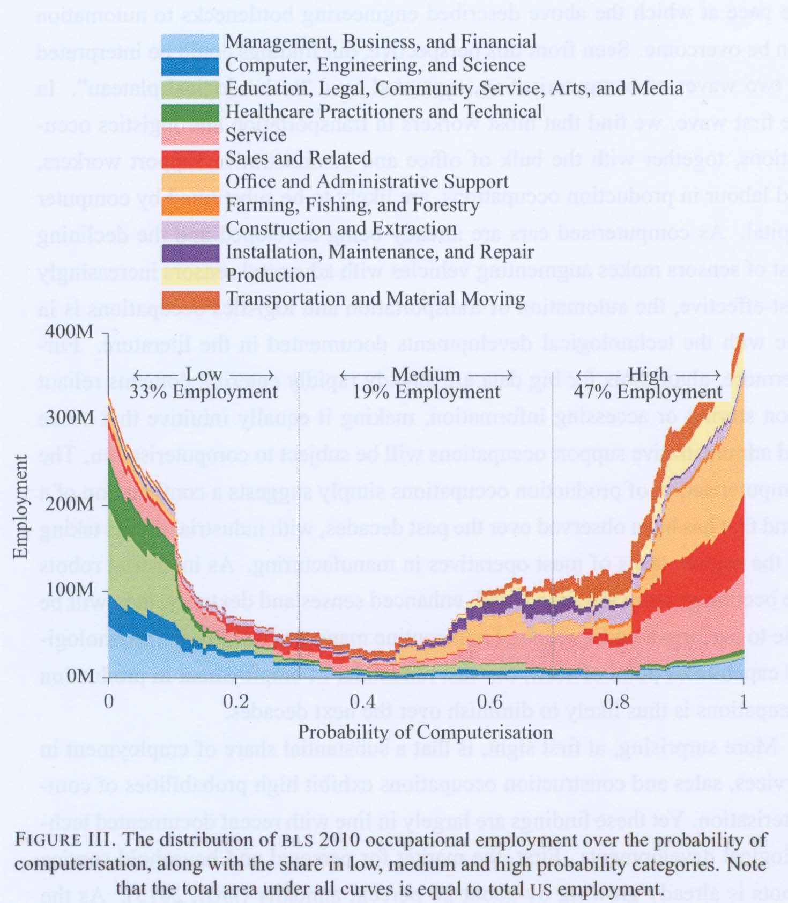
Job losses due to
computerisation
Frey, CB & Osborne, MA, ‘The
Future of employment: How
Susceptible are jobs to
Computerisation‘?’

Slide 23
Jobs which are forecast to disappear over the next two decades
Library technicians Clerks Telemarketers Restaurant cooks Farm labourers Dental technicians Machine setters Cashiers Real estate brokers Couriers | Agricultural technicians Bookkeepers Legal secretaries Drivers Sales workers Credit analysts Umpires/referees Insurance appraisers Loan officers Welders

Slide 24
Areas which are forecast to remain ‘safe’ from automation in the medium term
Fine motor skills and manipulation
Creative intelligence
Social intelligence

Slide 25
Regional growth industries
Construction
Education and training
Property and business services
Health and community services
Transport, warehousing and logistics
Tourism
Agriculture and related industries, including agri-business, agri-science, agri-tourism and agri-food
Advanced manufacturing
ICT (enabling industry)

Slide 26
Work skills for the future
Sense making - ability to determine deeper meanings
Social intelligence - ability to connect with others
Novel and adaptive thinking
Cross-cultural competency
Computational thinking – ability to translate data into abstract concepts and understand data-based reasoning
New-media literacy - ability to assess & develop content for new media forms and to use these for persuasive communication
Institute for the Future, Phoenix University, Future Work Skills for 2020

Slide 27
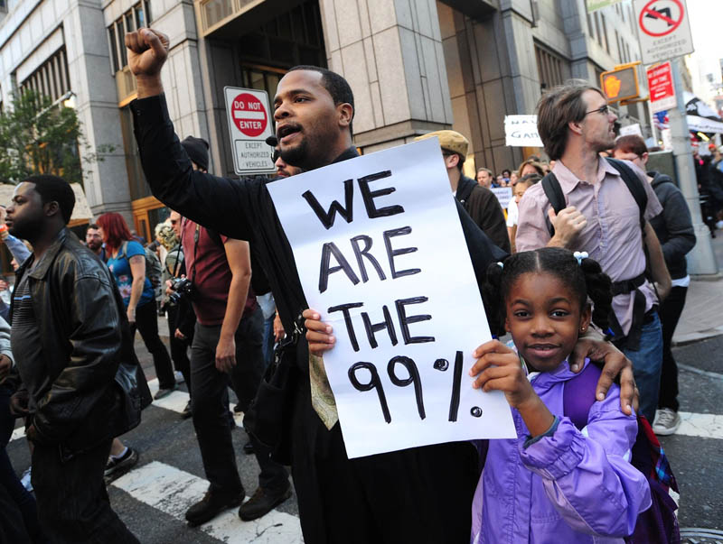
What might a post-capitalist world look like?
Graeber, David, 2011 (Professor of Anthropology, London School of Economics)

Slide 28
Post-capitalism
Possible because:
1. Technology is replacing jobs
2. Information is becoming so prolific and readily available that it is driving down prices
3. spontaneous rise of collaborative production (eg. Wikipedia)
Information can no longer be “owned” by Governments or corporations
Rise of informal “barter” networks
Money will become meaningless and cease to exist
Mason, Paul, “The End of Capitalism has Begun”, http://www.theguardian.com/books/2015/jul/17/postcapitalism-end-of-capitalism-begun

