Slide 1
The Value of Volunteers
16th October, 2018
Jen Walsh, Volunteer Coordinator
(Palliative Care)

Slide 2
Today’s Session:
Perception vs. Reality
“Success”
3 R’s
Limits & Boundaries
Organisational Culture

Slide 3
Volunteer Management
Perception vs. Reality

Slide 4
Perception
Recruit
Train
Place
(*Keep the cup in mind)
Notes:
There is a common perception that getting a volunteer up and running is an easy process. All you need to do is just recruit someone, train them, place them in their role, and then celebrate everything going to plan! Unfortunately, properly managing a volunteer team is a bit more complicated than that.
(Keep that cup in mind though – it’ll come up a few times)

Slide 5
Reality
Advertise
Recruit/ Interview
Match to role
Paperwork
Support
Mentor
Place in role
Train
Train
Support
Train
Recognise
Place in new role
Train
Support
Notes:
Now… don’t despair when you see this slide, I’ll walk you through it!
The reality of managing a volunteer team is much more complicated than what we saw on the last slide. (quickly walk them through each step)
It’s important to notice that Training, Mentoring & Supporting comes up multiple times – and that’s intentional. Volunteers are human beings – just like paid staff (not exactly a shock to anyone, I know!). But the point is, volunteers need to be fostered and developed just like a paid staff member. We would never expect to train a staff member one time, and then have years of high performance and success out of them. We train them and support them over time. As their needs change, we offer them different things. The same is true with volunteers. It’s also important to notice the green box – “Recognise.” We must take time to recognise volunteers. Also, the blue box says “Place in a New Role.” Gone are the days when every volunteer who comes through your doors wants to be in the same role for 40+ years. Some do, most don’t. As their experiences and interests evolve, it’s important to find roles that best suit them.

Slide 6
Reality… …with a dose of optimism → (ie: there’s hope!)
Notes:
But………. There’s hope!

Slide 7
Reality
Advertise
Recruit/ Interview
Match to role
Paperwork
Support
Mentor
Place in role
Train
Train
Support
Train
Recognise
Place in new role
Train
Support
Notes:
Here’s where our cup comes in again.
Each step in this complicated process gives us an opportunity for success.
At the point of recruitment, a volunteer may highlight a way in which you could streamline your paperwork. They might talk about a skill set that you didn’t realize would be useful in your organization.
During the training phase – volunteers have a lot to learn, but so do organizations if they’re willing to listen! If training is set up in a way that welcomes feedback, they can help you strengthen your sessions.
While supporting and mentoring volunteers you have an incredible opportunity to build their confidence. Confidence volunteers provide better service, commit to more shifts, and make the organisational culture happier.
Recognizing volunteers gives you a chance to reflect on the great work of volunteers – and makes them feel valued. Remember that recognition is both formal and informal.
Sometimes volunteers need a change. There’s nothing wrong with enabling them to find a new role in your organization. By doing this – they stay fresh, excited and engaged. Also, they might bring a fresh perspective to their new role!

Slide 8
What is success?
Notes:
We’ve seen this trophy come up a few times so far – so what does it mean? For the sake of this presentation we are equating it with “success.” So… what does a successful volunteer program look like for you?

Slide 9
How do you measure success?
Quantitative (numbers):
# of clients supports
# of volunteer hours
Qualitative (quality):
What “extra” supports were provided that wouldn’t exist without volunteer support?
What kind of feedback are you getting from clients?
What new ideas have volunteers offered?

Slide 10
The 3 R’s
Right person,
Right role,
Right time.

Slide 11
The Right Person
Who is the volunteer?
What are their reasons for volunteering?
What are their professional skills?
What are their personal skills?
Why did they chose YOUR organisation?
What hidden talents lie just under the surface?
✓ Are they “Right”? Then continue on!
X If not, do you know who to direct them to?

Slide 12
The Right Role
What is the role?
Why do you need this role?
Does it align with your “bigger” picture?
What skills do you need?
What type of person does the role need?
Who will invest in supporting the role?
✓ Is the role “Right”? Then continue on!
X If not, do you know how to make it right?

Slide 13
The Right Time
Is it the right time?
Do you need this role now?
Does their availability fit with what you need?
Weekly shifts,
Holidays,
Busy period, etc
Does a member of staff have time to invest?
✓ Is the timing “Right”? Then continue on!
X If not, when will it be right?

Slide 14
Limits & Boundaries
Notes:
Just like staff – volunteers need boundaries and limits to their roles. These aren’t meant to restrict them, they are meant to guide them and provide meaningful structure so that they can thrive in their role.

Slide 15
Good boundaries minimise problems!
Do you have the following in place?
Privacy & Confidentiality agreements
Clear role descriptions
A culture where volunteers know their strengths
A culture where volunteers know their limits

Slide 16
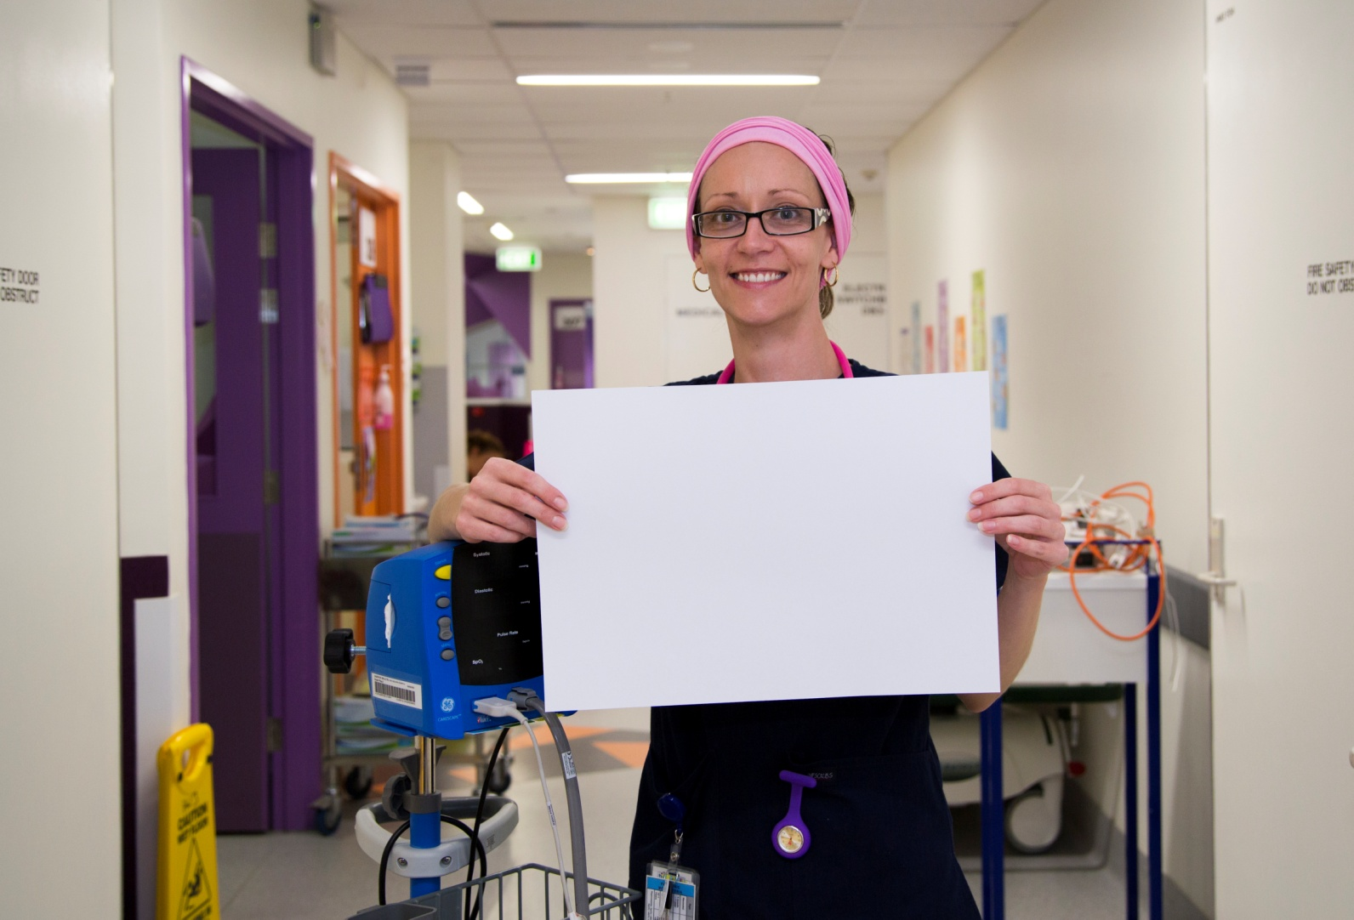
Organisational Culture
Volunteers are a vital part of the team.

Slide 17
What is your organizational culture?
Language matters:
“They are just volunteers.”
“Volunteers can’t do that.”
“We invest in training volunteers and then they leave.”
“Training is expensive.”
“We don’t have time to support volunteers.”

Slide 18
What is your organizational culture?
Refer to “Top 10 Reasons” handout.
How can you flip each of these around?

Slide 19
Back to the cup!
Volunteer Engagement &
Volunteer Satisfaction
Client Outcomes &
Client Satisfaction

Slide 20
Questions?
Jen Walsh, Volunteer Coordinator
(Palliative Care)
jwalsh@barwonhealth.org.au
4215 6161

