Slide 1
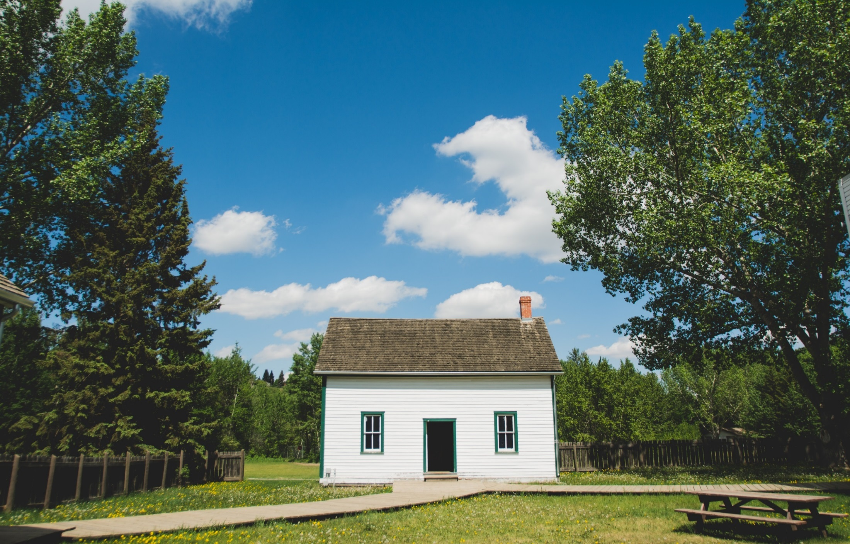
The role of Neighbourhood Houses in disaster management
A presentation to the Committee of Management

Slide 2
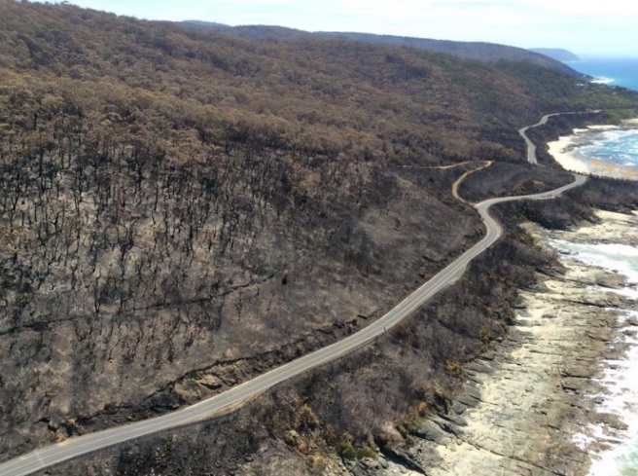
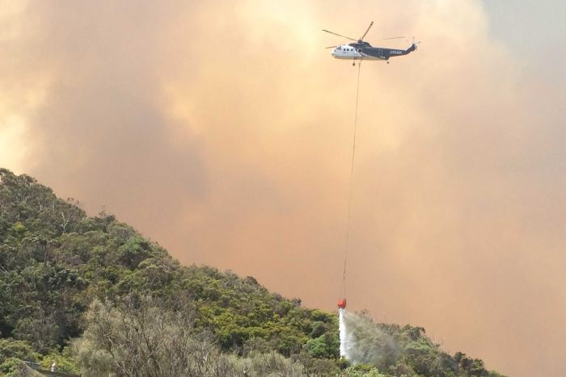
Impacts of disasters on the local community
2015 Wye River – Jamieson Track fire
The December 2015 Wye River bushfire has had a profound impact on the local community.
The State Government’s incident review report highlights the importance of the planning and management of arrangements that ensure the safety of communities during an incident.
The immediate response to ensure community safety included:
Communications
Evacuations
Community meetings
Planning for safety of vulnerable community members
Arranging relief centres
Local government and DHHS manage and coordinate recovery services. These are ongoing by the Colac Otway Shire through ‘WyeSep Connect’.
A community group recovery survey found access to courses on emergency management and community noticeboards are amongst the priorities for the recovering community.
Notes:
https://knowledge.aidr.org.au/media/2149/reviewoftheinitialresponsetothe2015wyeriverjamiesontrackfire-1.pdf

Slide 3
Where do Neighbourhood Houses fit in?
Given the increasing regularity and severity of natural disasters, developing Australia’s capacity to withstand and recover from them is critical.
The National Strategy for Disaster Resilience states that “community organisations are at the forefront of strengthening disaster resilience in Australia as it is to them that Australians often turn for support or advice”.
Neighbourhood Houses are an example of such an organisation.
NHs are informal, non-threatening and nurturing environments
NHs are connected to their local communities – including isolated and vulnerable members
NHs can connect people to services

Slide 4
Unique capacities and capabilities
Neighbourhood houses:
Provide and distribute information on services available to the community
Provide interaction, support and contact for transitioning population
Have a trusting relationship with the community and understand needs
Provide a safe and comfortable space
Facilitate relationship building through meetings and activities
Have recurrent funding ensuring continuity
Are flexible and responsive

Slide 5
These are all important factors of community resilience.
Building and growing these services by ensuring NHs are prepared and able to respond to natural disasters will enable continued community support, especially for vulnerable members.

Slide 6
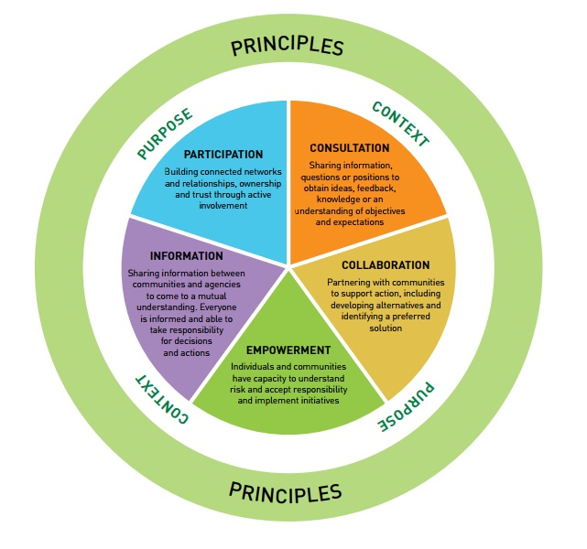
Community Engagement Model for Emergency Management
The National Strategy for Disaster Resilience emphasises community engagement and the importance of understanding the diversity, needs, strengths and vulnerabilities within communities.
Neighbourhood Houses engage with and understand the communities where they are located – this local knowledge is extremely valuable in emergency preparation, response and recovery.

Slide 7
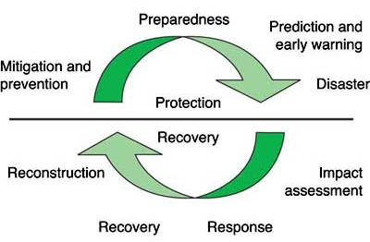
Disaster Management Cycle

Slide 8
Strengthening our role in preparation
Education of community
  The CFA provides community awareness, education and safety programs and well as education resources
  Red Cross REDiPlan session
  DEPI Fire Learning Network Program
  Incorporate into other training e.g. basic computer skills (fire safety)
  SES Fact Sheets
  Take part in council emergency management training
Reach out and link to other agencies
  Such as: CFA, SES, Red Cross, Local Council
  Foster cross-membership and volunteering
Formalise role through EMP – as a link between community and State level ‘command and control’ emergency services

Slide 9

Strengthening our role in response and recovery
Provide access to building - create a MOU between the NH, other NHs, and
the building owner (usually local government)
Communication of critical information
Information to emergency services about
community needs
Information on services to community
Be aware of issues such as family
violence after a disaster and post
traumatic stress disorder
Support and listening
Share experiences between NHs

Slide 10
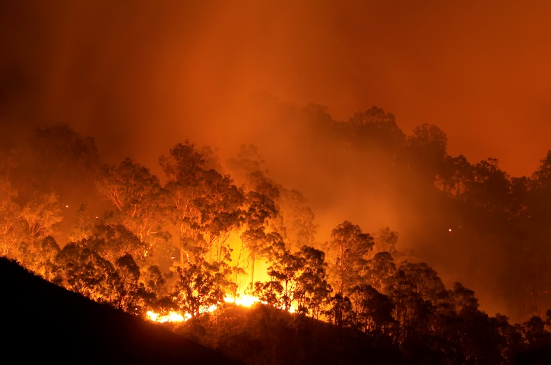
How to achieve?
Build and strengthen relationships between Neighbourhood house networks and emergency service organisations/ agencies/ council

Slide 11
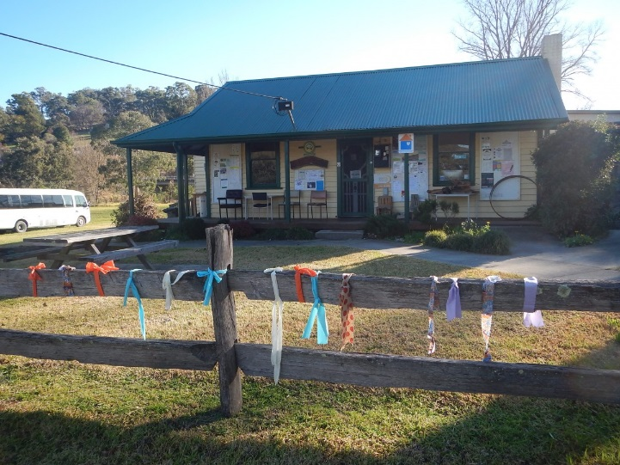
Example
Buchan Neighbourhood House (BNH)
Alpine Fires 2003
During two months of summer fires BNH became a ‘nerve centre’ for this isolated area and played a pivotal role in the recovery process
BNH coordinated and acted as a clearing house for donations and assistance from a variety of sources
Partnered with the local Bush Nursing Centre
Collect and tagged appliances damaged by the ash-polluted water supply, these families received compensation from the local water authority
Has since been building an accessible resource library on fire issues and prevention for the community
Has played a similar role in natural disasters since including drought and flood
Notes:
https://www.nhvic.org.au/documents/item/559

Slide 12
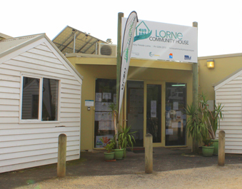
Example
Lorne Community House (LCH)
Great Ocean Road Fires 2015
In the aftermath of the Christmas Day fires that hit Wye River and Separation Creek, LCH became a safe haven, providing the community and extended community with emotional support
LCH opened the day after the fires despite Christmas period closure, putting additional programs in place
Effects of the fire were widespread and lasting, with community members continuing to utilise the LCH in the following 18 months as they resettled
Formal disaster management organisations (DHHS, Red Cross and local foundations) received additional funding for emergency response, however, no funds were made available for the LCH
LCH experienced internal issues with under-reporting of time spent on the fire, with an increase in hours each week for the first term
A key learning is recognising the unpredictability of many different variables in planning for natural disasters
Notes:
https://www.nhvic.org.au/documents/item/559

Slide 13

Proposed next steps
Committee of Management
Approve approach for our role before, during and after a disaster
to define what we will and will not do at these stages
Formally review and approve disaster management plan ‘Don’t Panic’ annually.
Network
Consider disaster vulnerabilities in each area and create a community education plan – share resources
Meet with relevant council staff member to discuss a cohesive approach to emergency preparedness

Slide 14
Questions?

