Slide 1



Welcome.
Samantha Dellamarta
Director
DelRoy Consulting

Slide 2

Welcome.
I would like to acknowledge that we meet on the lands of the Wathaurong (Wadawurrung) people and pay my respects to elders past and present, and any Aboriginal people here today.

Slide 3
Welcome
 | Workshop Schedule
9:30 | Welcome & Introduction
10:00 | The Project, The Framework & The Toolkit
10:30 | Gather
11:30 | Break
11:45 | Analyse
12:45 | Lunch
1:30 | Consult
2:15 | Top Ten
3:00

Slide 4

Module 1: Introduction
The Project
Strategic Planning Workshop 1
Strategic Planning
On site
Strategic Planning
Workshop 2
Understanding the Framework
Introduction to the Toolkit
Knowing what is out there
Knowing what to do with it
Analysing the data
Consulting with stakeholders
Setting strategic priorities
Turning priorities into achievable goals
Populating template
Plan promotion, monitoring and review processes
Strategic Planning
On site
Finalise Strategic Plan
Promote Strategic Plan
Implement Strategic Plan
Implement monitoring and review processes
Strategic Planning
1:1 Support
1:1 support session for Coordinators and CoG representatives re implementation
Strategic Plan Framework

Slide 5
Module 1: Introduction
Neighbourhood House Strategic Planning Framework
Community Need
Existing Data
Stakeholder Engagement
Committee Direction
Gather
Analyse
Consult
Review
Prioritise
Finalise
Monitor
Promote
Set Goals
Government / sector Reform
Relevant NH Guidelines & Principles
Strategic Plan Framework
Strategic Plan
Coordinator Annual Work Plan
Financial Plan / Annual Budget
Community Engagement Plan
Capital Plan

Slide 6
Timeline of Neighbourhood House Information Resources & Guidelines
What is out there??
NH & LC Sector Framework
2003
NH Good Practice Guide 2012
Multiple Benefits Report 2014
DHHS NHCP Guidelines 2016-2019
DHHS Service Agreement Monitoring Neighbourhood Houses (FOPMF Pilot) 2017
NH Networks: an information resource
2017
NH Sector Vision
NH Sector Purpose Statement
NH Sector Philosophy Statement
NH Victoria Sector Principles
NH Sector Practice Statement
NH Sector Practice Diagram
NH Sector Outcomes
Good Practice Guide Self Assessment System
6 Step NH Community Development Model
4 Practice Areas
NH Victoria Sector Principles
NH Good Practice Standards & Evidence
Participant Survey results
The Big Picture: the headlines
Behind the headlines
Program Aims
Program Requirements
Funding Requirements
Reporting Requirements
6 Step NH Community Development Model
NH Victoria Sector Principles
Guide for Committees of Management
Annual Step by Step process for Service Agreement Monitoring for NH: processes for coordinators, networks and DHHS staff.
Service Agreement Monitoring for NH Checklist
List of Applicable Departmental Policies
NH Sector Vision
NH Sector Purpose Statement
NH Sector Philosophy Statement
NH Victoria Sector Principles
NH Network Style of Practice: Key tasks
NH Sector Practice Statement
NH Sector Practice Diagram
NH Sector Outcomes

Slide 7

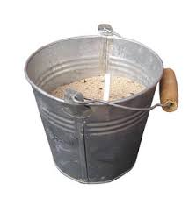
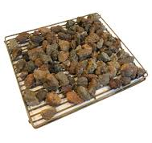
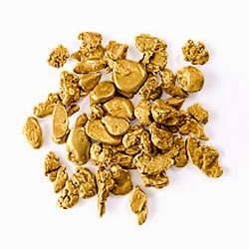

Module 2: Gather
information
source
tools
findings
priorities

Slide 8
Module 2: Gather
Information Sources
Information Gathering Tools
Foundational:
Previous Strategic Plan
Analyse This: prompting tool.
Funded Organisations Performance Monitoring Framework
FOPMF Recommendations & Actions Table
NH Survey 2016
FOPMF Strengths & Weaknesses
NH Participant Survey 2013
NH Good Practice Guidelines 2012
Advanced:
ABS Census 2016
NH Good Practice Self Assessment
G21 Regional Data
Analyse This: prompting tool.
Funders / Service Agreements
The information you can draw from these sources, using these tools, is ideal for developing a Strategic Plan, but this data is also incredibly useful for a whole range of other things including marketing, annual plans, funding submissions and centre profiling.

Slide 9
Module 2: Gather
Centre Profiling
How well do you know your centre?
What is your centre’s story?
What do people need to know?
Create a profile for your centre, and share it!
Strategic Plan Framework
BNNC Profile
Do you have a Vision, Mission & Values?
Does anyone know about them?
What are you most proud of?
Who are your participants?

Slide 10
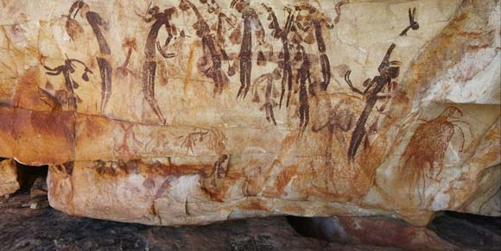

Gwion Gwion (Bradshaw) figures. These figures are from the sash era. Photo: Kimberley Foundation Australia
Source: https://www.creativespirits.info/aboriginalculture/arts/bradshaw-gwion-gwion-rock-art#ixzz4z9btzzSI

Slide 11

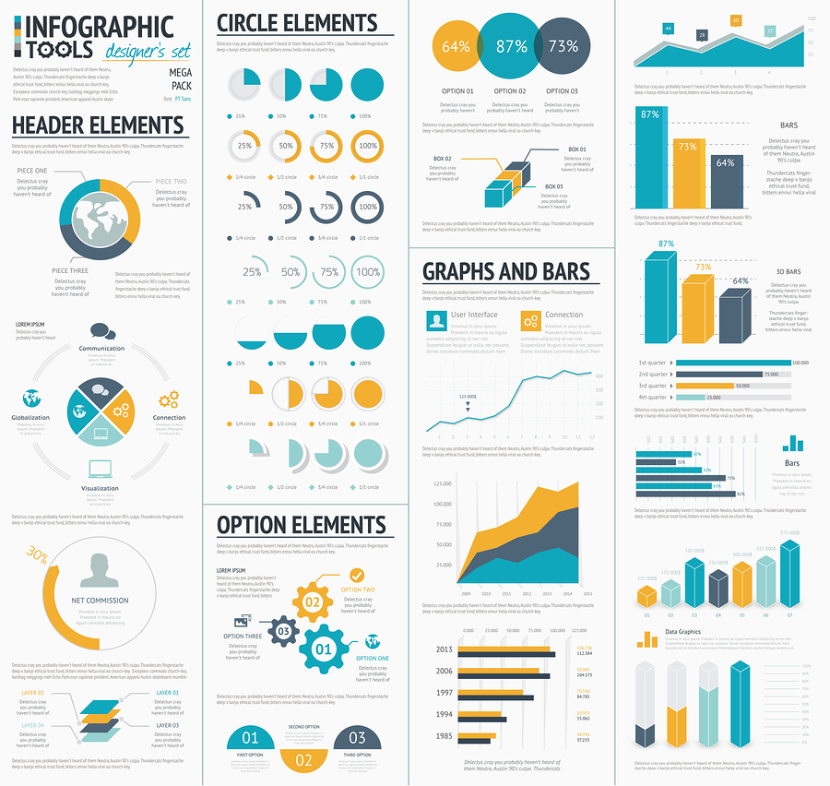


Slide 12





Module 2: Gather
Activity
Using your NH Survey 2016 results, find the top ten most important details about your centre and write them down.
Now, using the myriad of art supplies in front of you, create you own infographic.
This is your first draft, but now that you have your ‘Top 10 important things to do know about our centre’ list you can explore the art of infographics at a later date.
There are apps and guidelines and programs available on line
OR
You could invite children to help you do it!
Useful tips
Use simple and familiar symbols!
Numbers are great for telling stories!
90% of participants…
14 community partners
7 volunteers
378 volunteer hours

Slide 13
Module 3: Analyse
Analyse This: prompting tool.

Slide 14
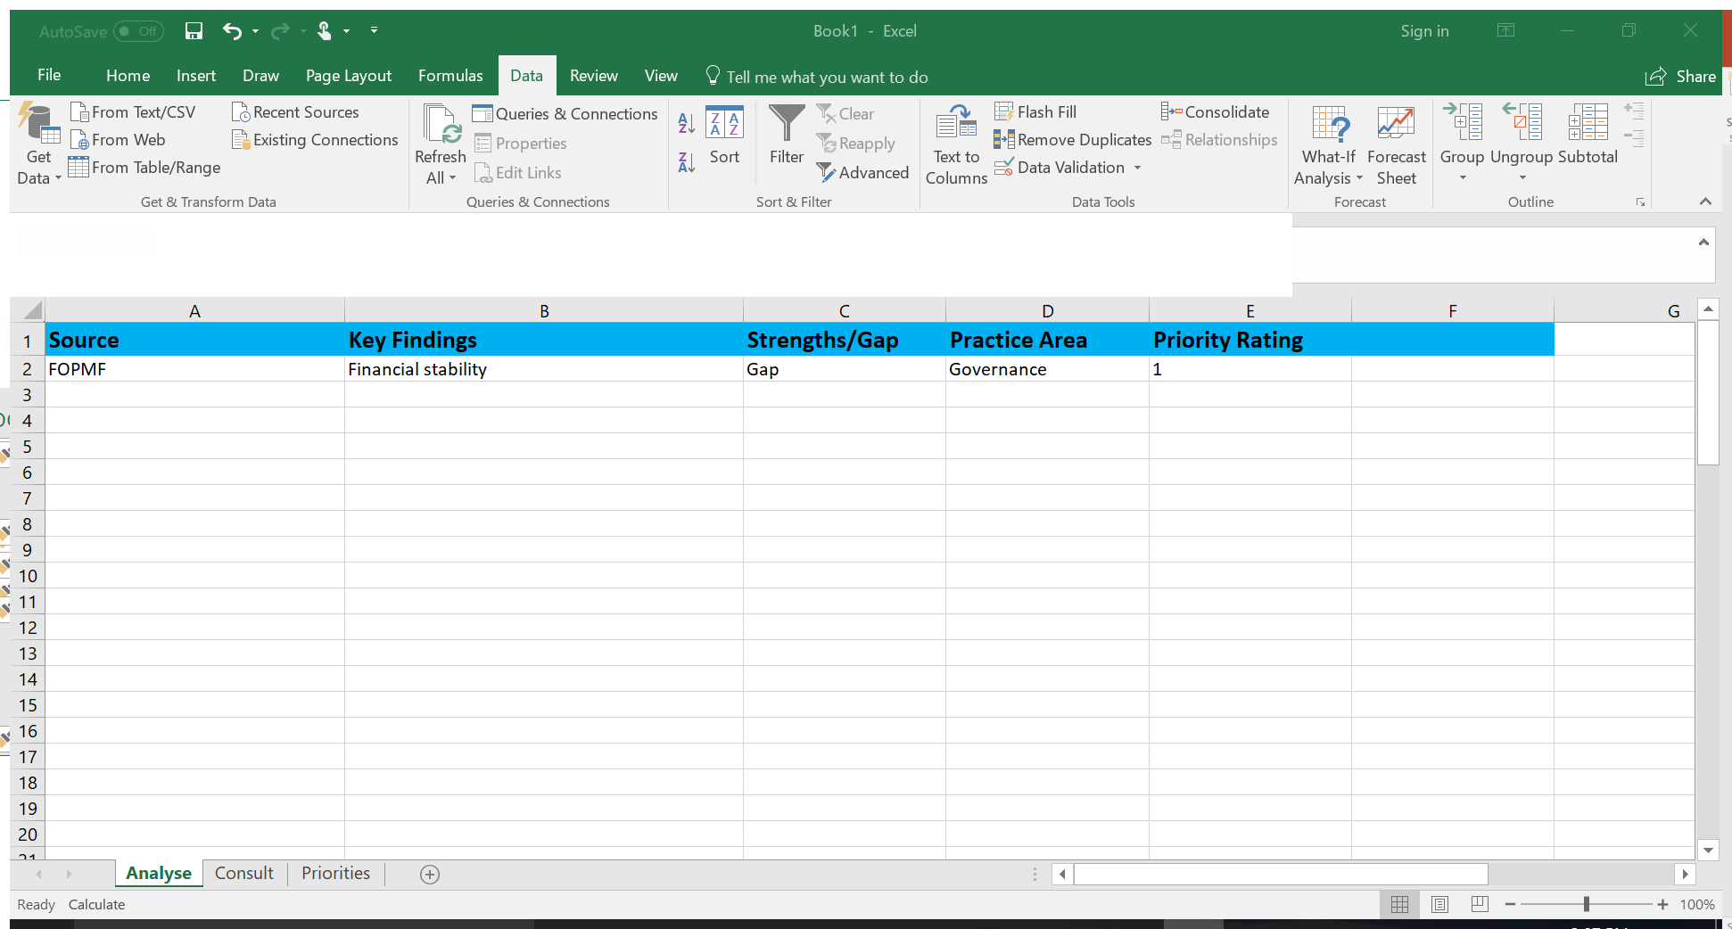
Module 3: Analyse
Information Hub

Slide 15
Module 3: Analyse
Activity
trengths
eaknesses
pportunities
hreats

Slide 16
Module 4: Consult
Consultation Sources
Consulting Tools
Existing:
NH Participation Survey 2013
House - specific Participant Surveys
Current participants
Partner Surveys
Previous participants
Complaints & Feedback
Potential participants
Suggestion boxes
Partners
Staff & Volunteers
Social Media
LGA Community Plans
Survey Monkey
Broader community sector
Staff & Volunteer Survey
Open days / events
Advanced:
Analyse This: prompting tool.
Reference Groups
Consultation Workshops

Slide 17

Module 4: Consult
Suggestions……
Don’t underestimate the value of staff and volunteers.
Don’t underestimate the value of the voices of children and young people or people with a disability.
Ensure you have offered a variety of consulting methods that are inclusive and accessible to ALL people.
Database. Database. Database.
Determine if you value one cohort of stakeholder’s views over another. It is important to ensure transparency in relation to decision making. It is possible, even likely that Committee members will not share the views of participants, so how is this conflict managed? Can the Committee ‘trump’ the community when it comes to priorities?
For an effective approach to a survey or consultation, simply ask: “What do you think we should STOP, START and CONTINUE to do.”
Stop
Start
Continue
Prizes! You can offer bribes incentives for participation in consultation processes.
Feed it back! The views of participants and the broader community are invaluable. They deserve to know what impact their views have had. Use direct quotes to acknowledge their contributions.

Slide 18
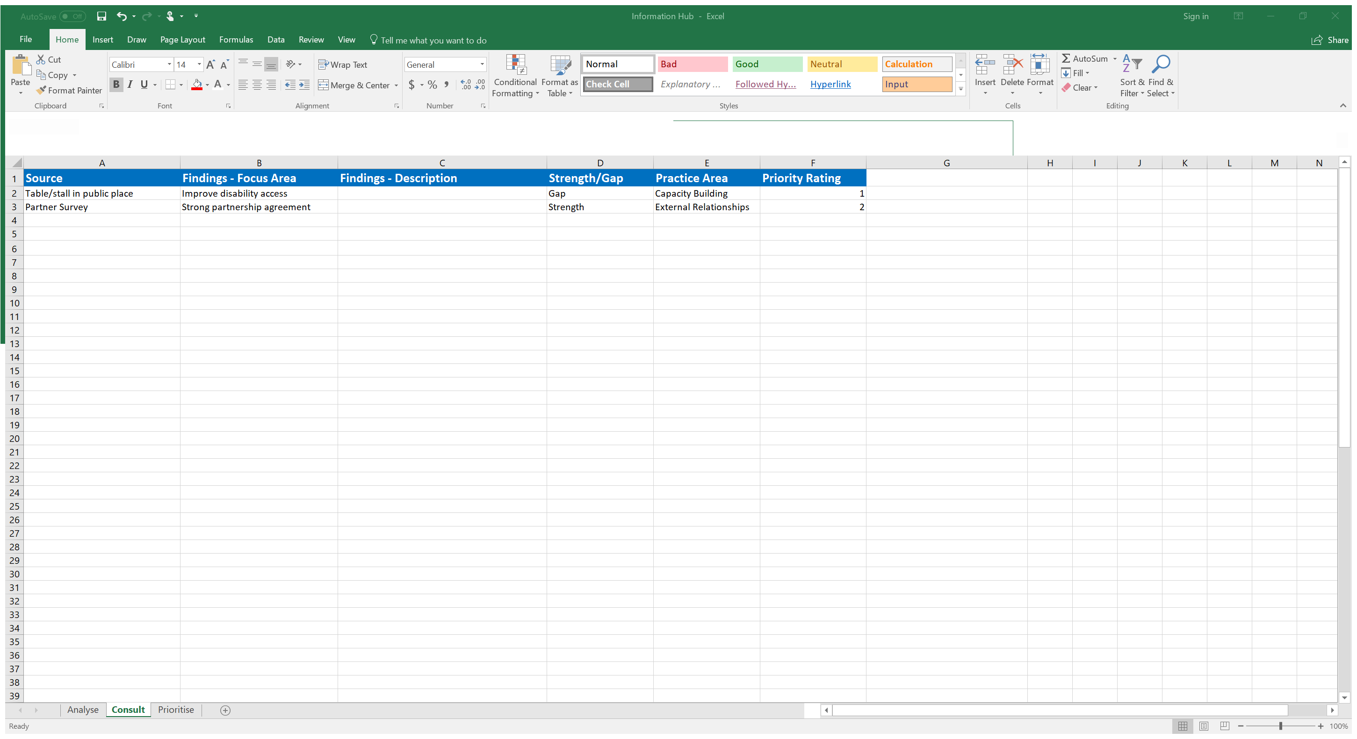
Module 4: Consult
Information Hub

Slide 19
Module 4: Consult
Activity
Methods
NH Participant Survey 2013 Census
Complaints
Partner Survey
Community consultation
Consult other organisations
LGA community plans
Participant Survey
Community Survey
Suggestion box in House/Centre
Suggestion box online
Table/stall in public place
Open days
Social media feedback

Slide 20
Module 5: Prioritise
Shifting from BIG PICTURE to SMALL and DISCRETE
Next steps:
  1. Once you have completed the Information Hub Analyse and Consult tabs, go to the Prioritise tab.
  2. You are going to transfer all of your Priority Rating 1 items into this table. You can do this by filtering the original tab to show Priority Ratings 1 only then cut and paste across. Or you can filter by Practice Area, then Priority Rating.
  You will not need to transfer the Source column or the Priority Rating column.
  3. You can print the Prioritise page and provide the list to the Committee to inform their discussions and final prioritising process.
Don’t forget to select ‘FIT SHEET ON ONE PAGE’ when printing.
  4. It is recommended that you provide the Committee with 3-4 Focus Areas for each Practice Area. Dip into the Focus Areas with Priority Rating 2 if you need to.
  5. Present these to your Committee. The aim is to reduce these to 1-3 Focus Areas to bring to Workshop 2. Together, you can merge some Focus Areas into one, or we can do that later.
  6. Using the last column in the Prioritise tab, update the results of the Committee discussion and bring this new list to Workshop 2.
Remember, they are suppose to be high-level and broad – we will narrow them down through the goal setting process and you will break them down even further in your Coordinators Workplan.

Slide 21
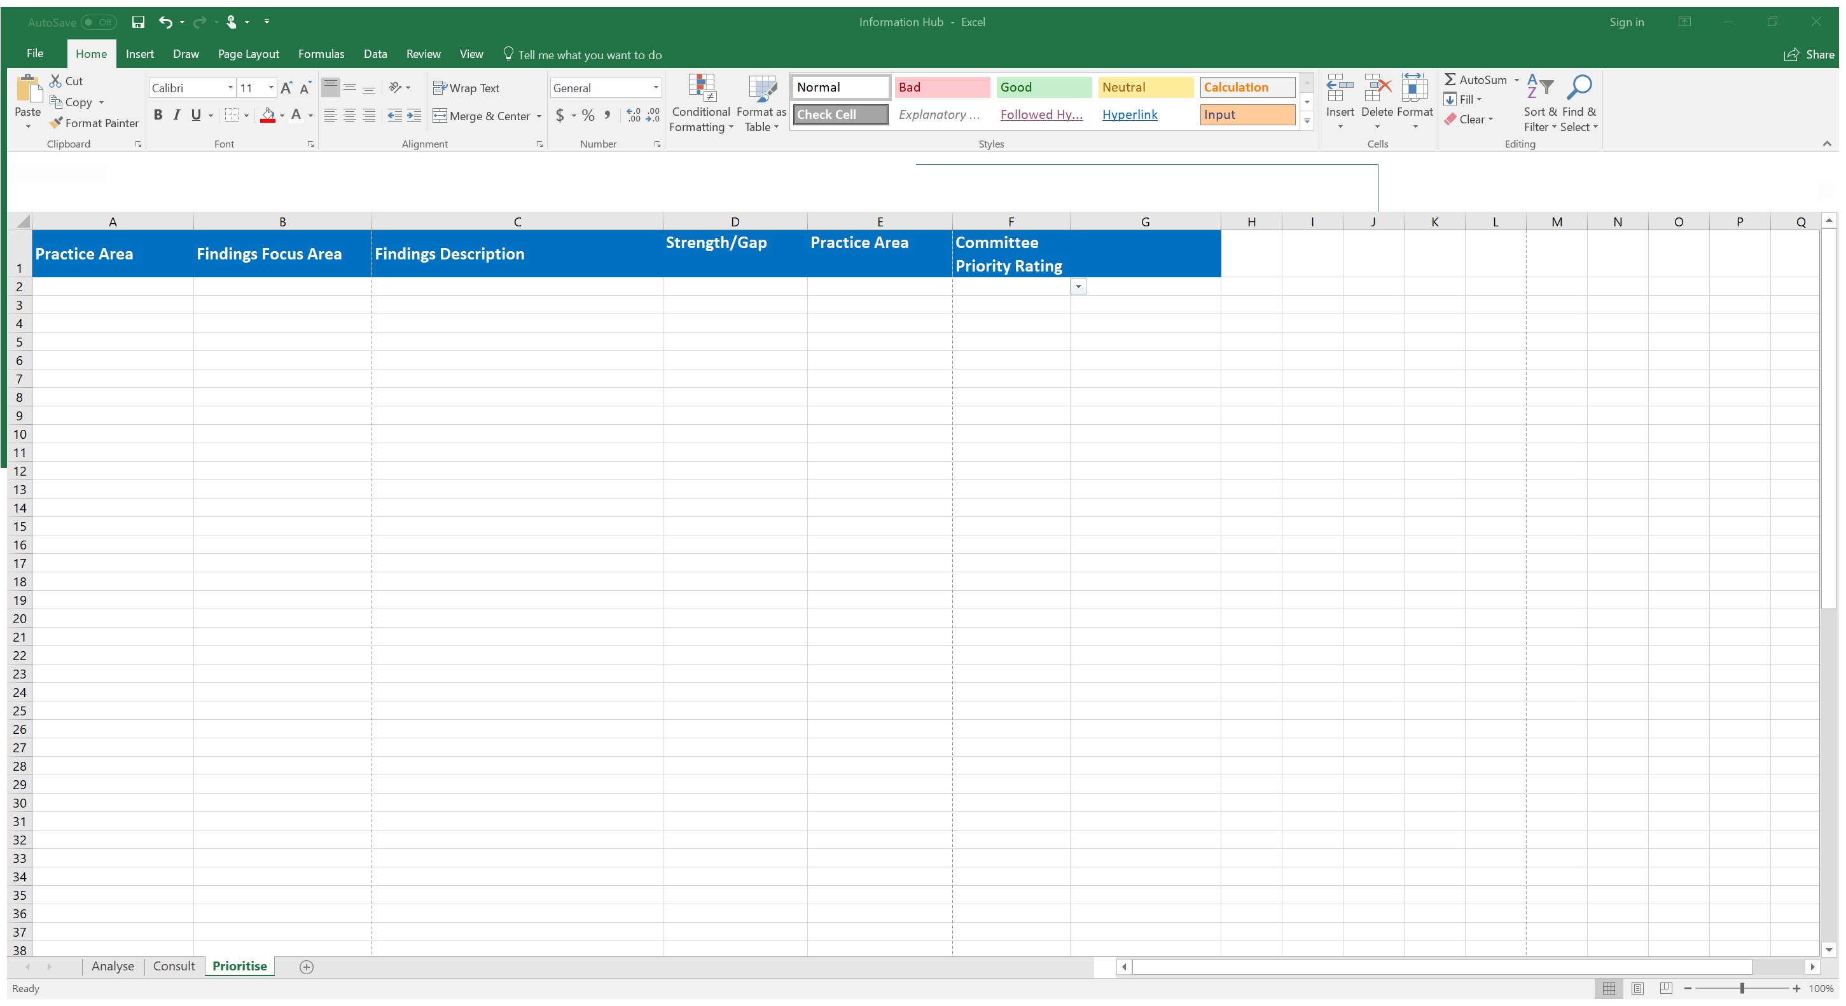
Module 5: Prioritise
Information Hub

Slide 22
Module 5: Prioritise
What not to do.
Tips for avoiding conflict during the ‘prioritising’ step:
Provide the short list in advance. Some people need time to consider what is in front of them and you won’t get their buy in if they feel pressured or rushed.
Come prepared. Bring the short list but make sure the long list is accessible in case anyone questions what you are presenting.
Be flexible – focus areas can be broadened or narrowed down for greater impact if necessary.
Use the data. Data is evidence. Evidence trumps opinion.
Make sure all parties have their chance to speak and voice their views
Tips for getting ‘buy in’ from Committees:
Make sure everyone has a chance to contribute even those who are not present at the time.
Allocate tasks based on expertise and skill – marketing, graphic designing, launch events, public speaking – there are a range of tasks to get everyone inbvolved and take some pressure off you!

Slide 23
Module 5: Prioritise
Activity
Take a few minutes to discuss any concerns you may have about the following:
Getting participant ‘buy in’
Getting Committee ‘buy in’
Squeaky wheels
Other anticipated conflicts
Removing names, personalities and other identifying traits, troubleshoot your concerns with the group next to you and come up with a list of solutions.

Slide 24
Examples of Strategic Plans
Example 2
Example 1
Example 3
Example 5
Example 4

Slide 25
Workshop 2 Preparation Template
GOVERNANCE
Focus Area 1 (strength)
Focus Area 2 (gap)
EXTERNAL RELATIONSHIPS
Focus Area 1 (strength)
CAPACITY BUILDING
Focus Area 1 (strength)
MANAGEMENT
DELIVERY & OPERATIONS
Focus Area 3 (gap)
Focus Area 1 (strength)
Focus Area 2 (gap)
Focus Area (gap)
Focus Area 1 (strength)
Focus Area 2 (gap)
Focus Area (gap)
Focus Area 2 (gap)
Focus Area 3 (gap)
Focus Area 2 (gap)
Focus Area 3 (gap)
GOVERNANCE
Goal
EXTERNAL RELATIONSHIPS
Goal
CAPACITY BUILDING
Goal
MANAGEMENT
DELIVERY & OPERATIONS
Goal
Goal

